Slide 1
Code Execution during peer review with CODECHECK
Talks.cam RSE Seminar
October 19 2023
Daniel Nüst & all CODECHECK supporters
https://bit.ly/check-cam
Notes:
Should be “inspiring”

Slide 2
Closed and irreproducible research
✔️
❌
🎓
❌
⁉️
♻️
❌
💡
❌
Notes:
Here are some of the problems with closed and irreproducible research:
It cannot be fully understood nor 🖱️ verified.
It obstructs effective 🖱️ reuse and extension, therefore it is not sustainable.
It prevents usage in 🖱️ education and citizen science.
And it slows 🖱️ innovation through closeness and repetition.

Slide 3
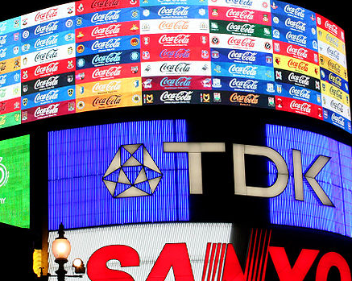
Claerbout’s claim:
An article about computational science in
a scientific publication is not the
scholarship itself, it is merely advertising
of the scholarship. The actual scholarship
is the complete software development
environment and the complete set of
instructions which generated the figures.
https://doi.org/10.1190/1.1822162
https://doi.org/10.1007/978-1-4612-2544-7_5
CC-BY 3.0, Sebastian Bertalan, Wikimedia Commons
Notes:
This is of course also the case for all AGILE and Earths System Sciene papers that use data and code.

Slide 4
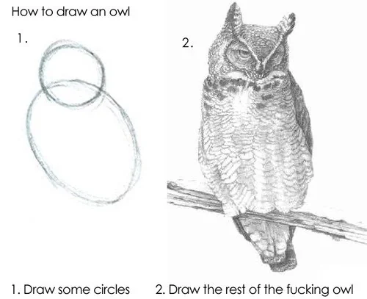
https://www.reddit.com/r/pics/comments/d3zhx/how_to_draw_an_owl/
Notes:
https://amp.knowyourmeme.com/memes/how-to-draw-an-owl

Slide 5
One thing
Have a README: all else is details.
Show willingness to help, but don’t stop publishing because lacking docs.
Hard to document for someone else > document for future you, add more on demand.
Rule 1 inspired by Greg Wilson’s Teching Tech Together (http://teachtogether.tech/en/index.html) Rule 1.

Slide 6
Four things on reproducible research
Have a README: all else is details.
Have a colleague run your workflow before submission.
Practically reproduce papers (or return the favour 👆).
Publish code and data, ask for it (as reviewer), cite it.
Rule 1 inspired by Greg Wilson’s Teching Tech Together (http://teachtogether.tech/en/index.html) Rule 1.

Slide 7
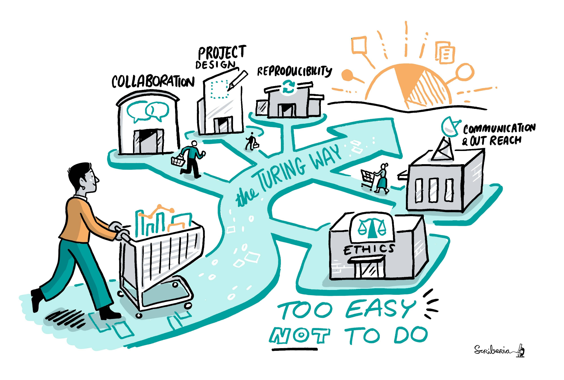
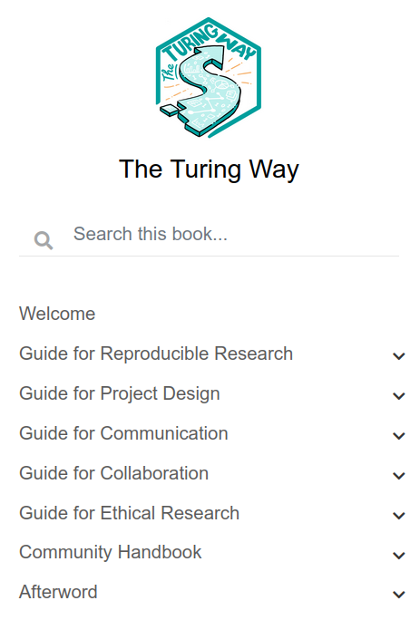
The Turing Way > https://the-turing-way.netlify.app/
The Turing Way project illustration by Scriberia. Zenodo. http://doi.org/10.5281/zenodo.3332807¶

Slide 8


Reproducible Research
Peer Review
Reproducible research and peer review are cornerstones of science.
But are they getting along?
https://giphy.com/gifs/suspicious-YNEpBZC0Ly08M https://giphy.com/gifs/lol-futurama-humor-cFgb5p5e1My3K
Notes:
It sometimes seems like reproducible research and peer review are not getting along, they might even suspiciously eye each other.
If software is so important for science, why is it largely neglected during peer review?
The easy answer is simply it is “extra work”, but I think it is worth noting that the lack of reproducibility during peer review is just one of many challenges that science faces.
My important message for today: reproducibility is something that actually can, and should, be determined as part of a peer review process!
In the rest of the talk, I will present two community-led approaches to increase reproducibility. Then, I’ll try to provide a brief overview of what you can do as a researchers to work more reproducibly.

Slide 9
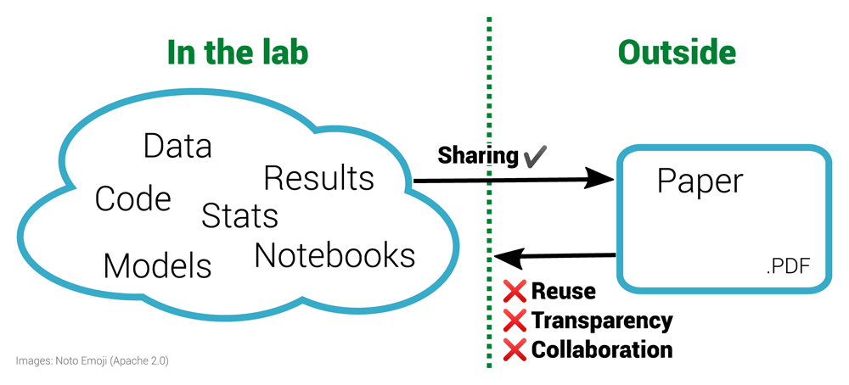
The inverse problem in reproducible research. Figure 1 of https://doi.org/10.12688/f1000research.51738.1
The left half of the diagram shows a diverse range of materials used within a laboratory. These materials are often then condensed for sharing with the outside world via the research paper, a static PDF document. Working backwards from the PDF to the underlying materials is impossible. This prohibits reuse and is not only non-transparent for a specific paper but is also ineffective for science as a whole. By sharing the materials on the left, others outside the lab can enhance this work.
Notes:
CODECHECK is motivated by the already mentioned breakage in science. We do not share all the building blocks of research, but communicate via, effectively, printed documents. This prohibits reuse and collaboration. It is simply ineffective, a waste of time and money.

Slide 10
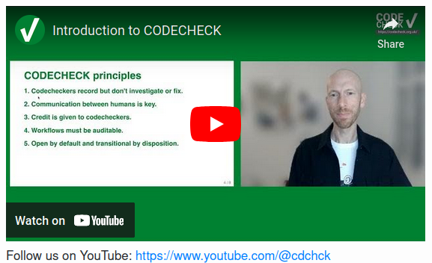

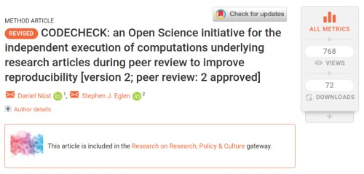


Independent execution of computations underlying research articles.
Principles
Codecheckers record
but don’t investigate or fix.
Communication between humans is key.
Credit is given to codecheckers.
Workflows must be auditable.
Open by default and
transitional by disposition.
🔏
60+ Certificates https://codecheck.org.uk/register/
Notes:
This review process is an implementation of the CODECHECK principles.

Slide 11

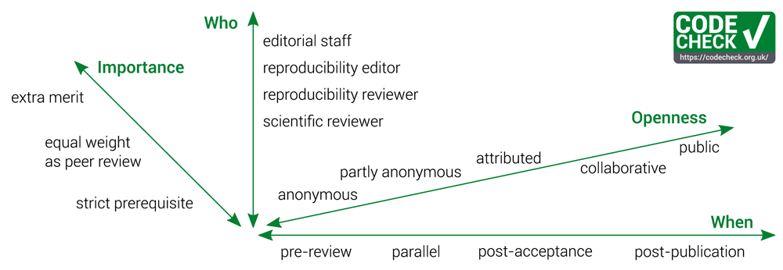
One re-execution of computational workflow by codechecker during peer review
👶
👩‍💻
The CODECHECK variations. Figure 1 of https://doi.org/10.12688/f1000research.51738.1
Notes:
A CODECHECK means that a single person, the codechecker, is able to execute a computational workflow at one point in time using the material provided by the author. The codechecker should not get relevant errors doing so, and get results that are not contradicting the original results. This is by design a very limited scope. It places little burden on the authors - they share what they have, and puts the trust in a person instead of requiring infrastructure or technological expertise. Just like peer review puts its trust in researchers as reviewers. CODECHECK’s scope gives flexibility, no standards or specific infrastructure is needed.
CODECHECK is built on five principles: [...]
If a CODECHECK is completed, there is a badge
and a certificate that we publish in a citable way with a DOI.
To date, 30 such certificates have been published, in which the codechecker shares their personal evaluation openly and transparently.
A CODECHECK can be implemented in many ways, varying depending on the existing procedures of journals or common community practices.
It can not only happen at different points in time or varying degrees of openness and power or importance, but also can be completed by different roles. Especially
early career researchers could be excellent candidates to be introduced to peer reviewing in this way. More importantly, they often have the required up-to-date expertise in technology and a large interest in learning methods, not just evaluating them. And the learning experience is one of the main motivation we are told that volunteer codecheckers are interested in, and one I can personally confirm - if you reproduce someone else’s work, you always learn something, and always can contribute back something.
-------------------------
1. Codecheckers record but don’t investigate or fix.
The codechecker follows the author’s instructions to run the code. If instructions are unclear, or if code does not run, the codechecker tells the author. We believe that the job of the codechecker is not to fix these problems but simply to report them to the author and await a fix. The level of documentation required for third parties to reproduce a workflow is hard to get right, and too often this uncertainty leads researchers to give up and not document it at all. The conversation with a codechecker fixes this problem.
2. Communication between humans is key.
Some code may work without any interaction, e.g. 21, but often there are hidden dependencies that need adjusting for a particular system. Allowing the codechecker to communicate directly and openly with the author make this process as constructive as possible; routing this conversation (possibly anonymously) through a publisher would introduce delays and inhibit community building.
3. Credit is given to codecheckers.
The value of performing a CODECHECK is comparable to that of a peer review, and it may require a similar amount of time. Therefore, the codechecker’s activity should be recorded, ideally in the published paper. The public record can be realised by publishing the certificate in a citable form (i.e., with a DOI), by listing codecheckers on the journal’s website or, ideally, by publishing the checks alongside peer review activities in public databases.
4. Workflows must be auditable.
The codechecker should have sufficient material to validate the workflow outputs submitted by the authors. Stark²² calls this “preproducibility” and the ICERM report¹¹ defines the level “Auditable Research” similarly. Communities can establish their own good practices or adapt generic concepts and practical tools, such as publishing all building blocks of science in a research compendium (cf. https://research-compendium.science/) or “repro-pack”²³. A completed check means that code could be executed at least once using the provided instructions, and, therefore, all code and data was given and could be investigated more deeply or extended in the future. Ideally, this is a “one click” step, but achieving this requires particular skills and a sufficient level of documentation for third parties. Furthermore, automation may lead to people gaming the system or reliance on technology, which can often hide important details. All such aspects can reduce the understandability of the material, so we estimate our approach to codechecking, done without automation and with open human communication, to be a simple way to ensure long-term transparency and usefulness. We acknowledge that others have argued in favour of bitwise reproducibility because, in the long run, it can be automated (e.g., https://twitter.com/khinsen/status/1242842759733665799), but until then we need CODECHECK’s approach.
5. Open by default and transitional by disposition.
Unless there are strong reasons to the contrary (e.g., sensitive data on human subjects), all code and data, both from author and codechecker, will be made freely available when the certificate is published. Openness is not required for the paper itself, to accommodate journals in their transition to Open Access models. The code and data publication should follow community good practices. Ultimately we may find that CODECHECK activities are subsumed within peer review.

Slide 12
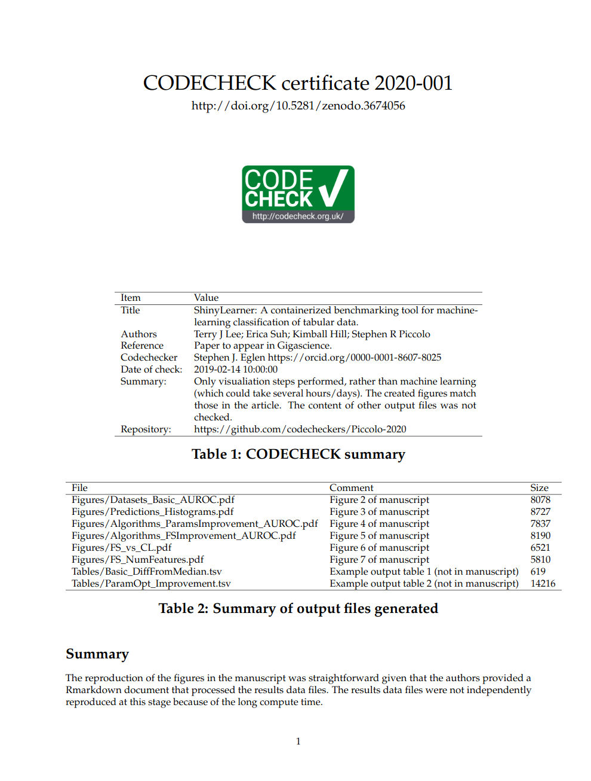
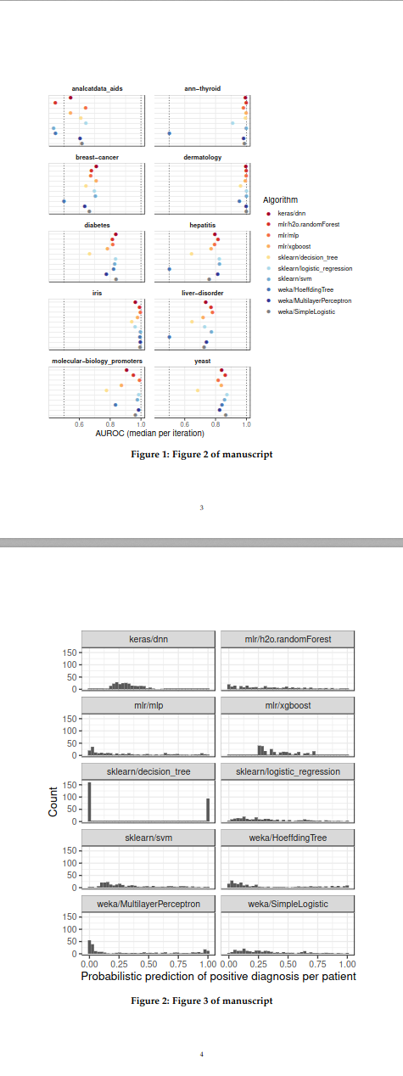
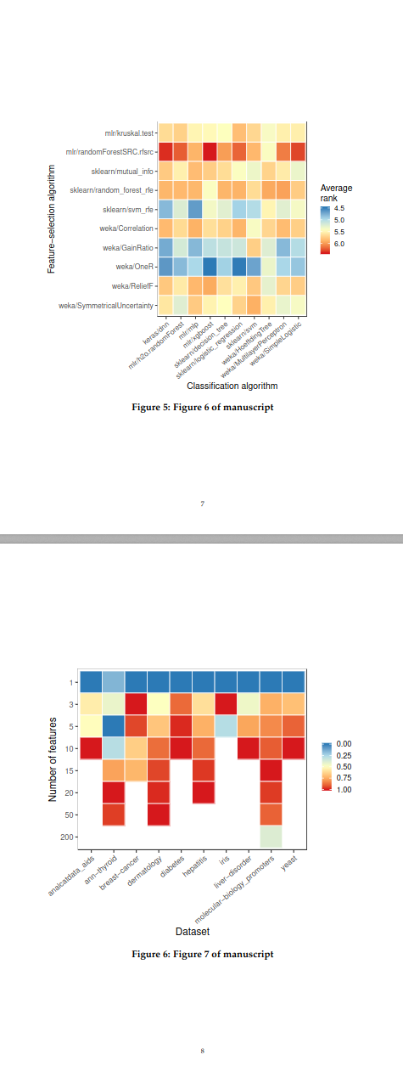
http://doi.org/10.5281/zenodo.3674056

Slide 13
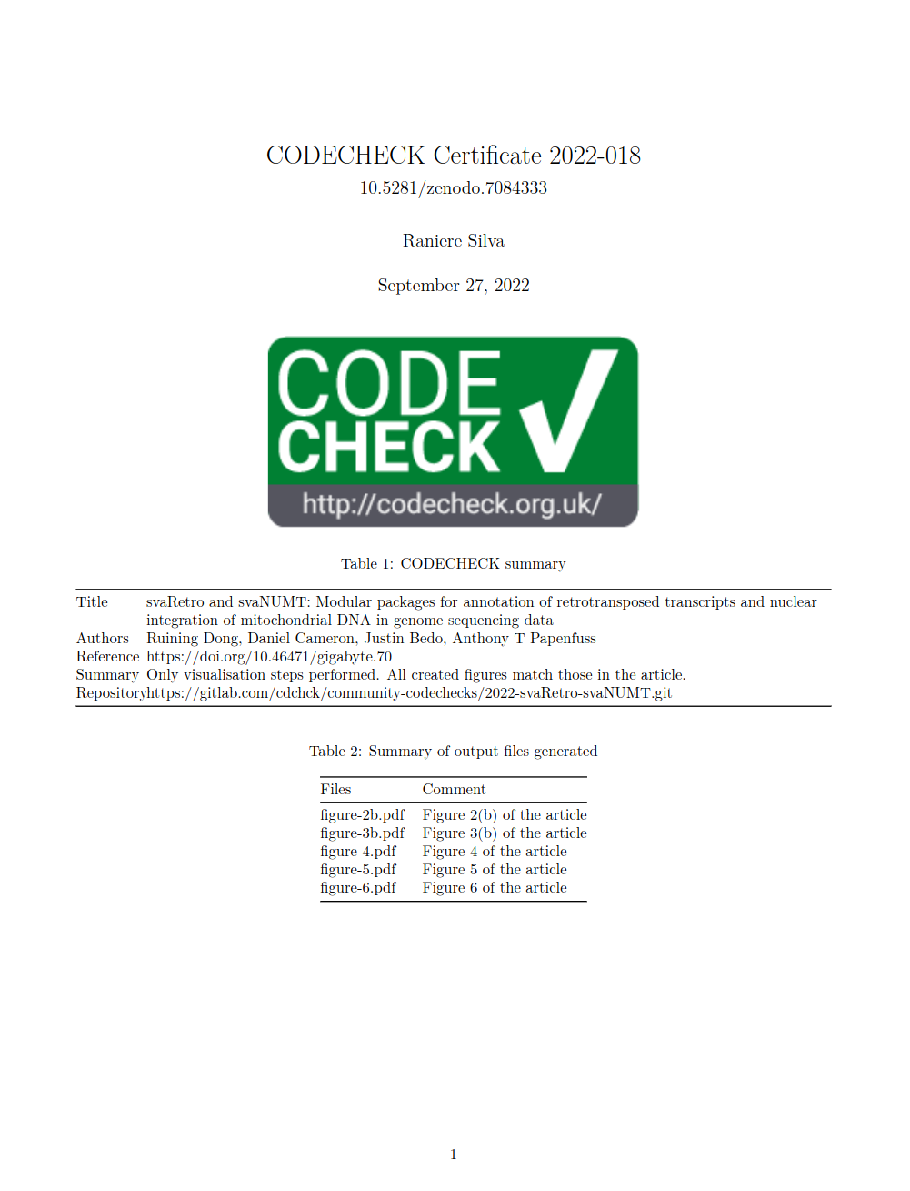
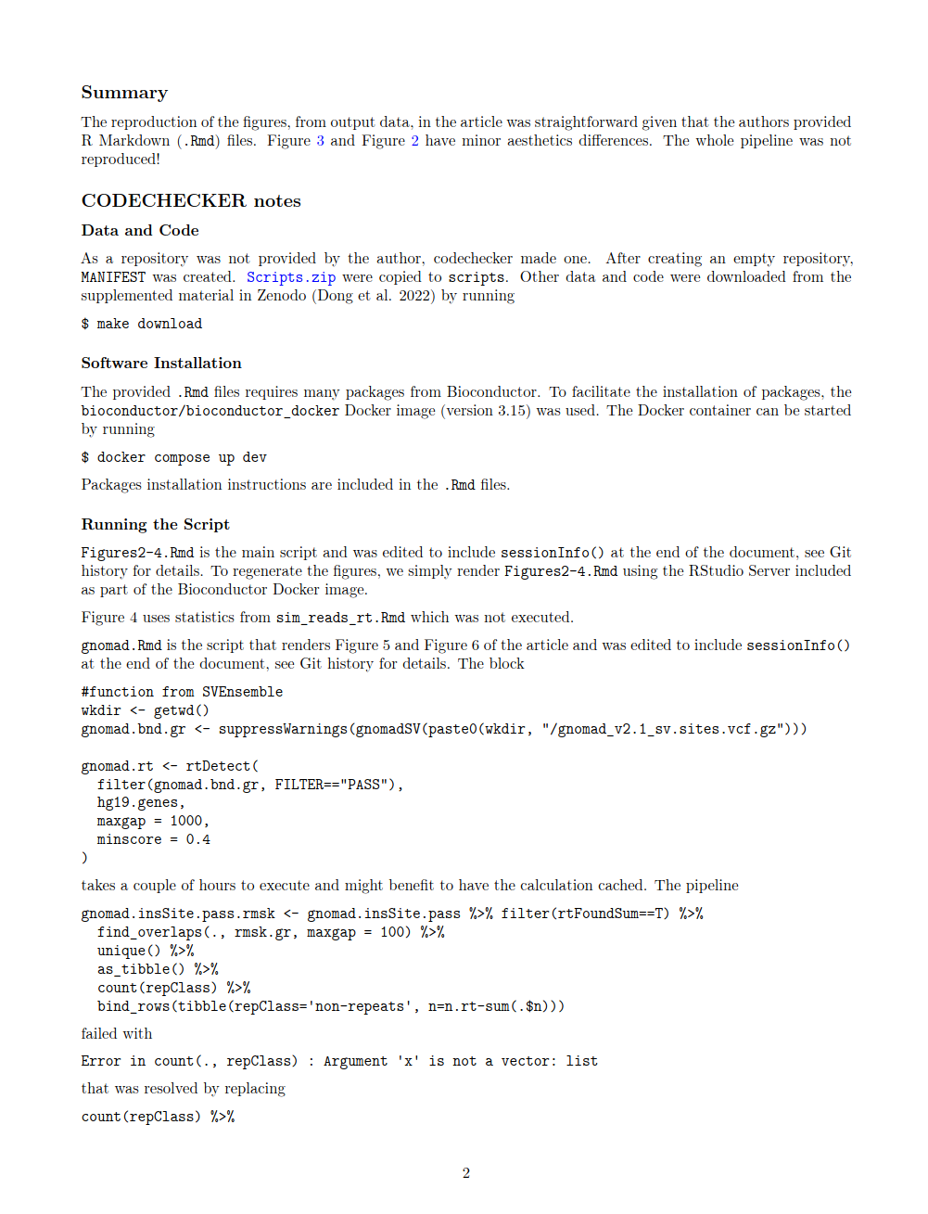
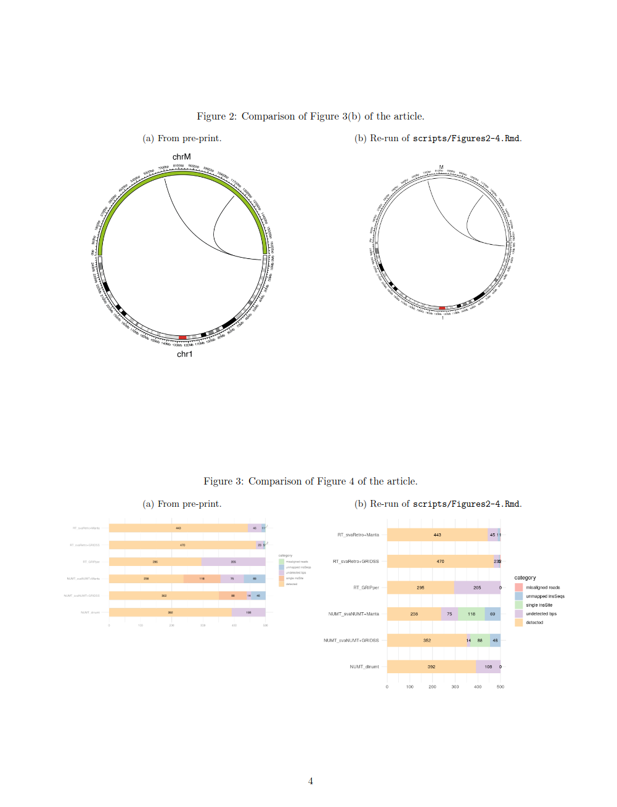
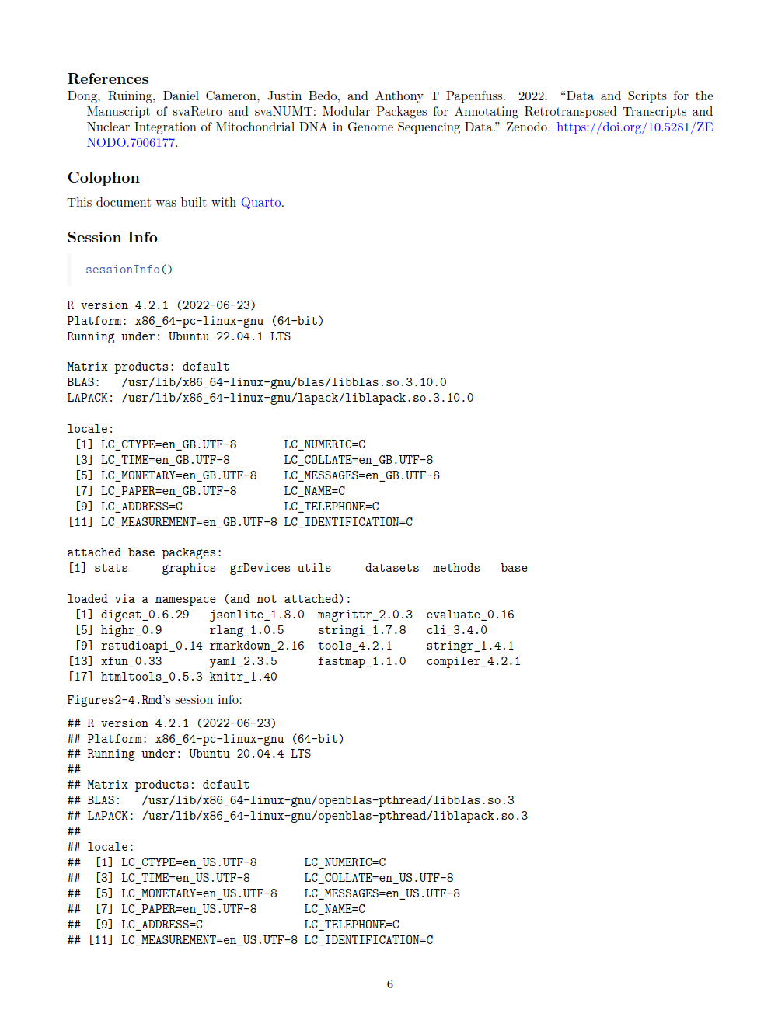
https://doi.org/10.5281/zenodo.7084333

Slide 14
Reproducible AGILE

Slide 15
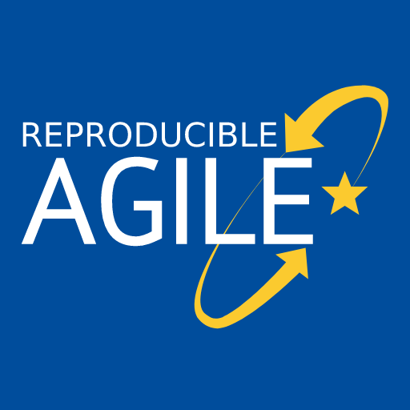
https://reproducible-agile.github.io/
2017, ‘18 & ‘19: Workshops on reproducibility
2019: Reproducible publications at AGILE conferences
(AGILE Initiative supported by AGILE Council)
2020: First AGILE reproducibility review
2021: Second AGILE reproducibility review
2022: Third AGILE reproducibility review - guidelines mandatory
2023…2024…
Notes:
Two workshops in 2017 and 2018 and a piece of meta-research into the reproducibility of papers published at the AGILE conference were the basis for a small group from the AGILE community to apply for an initiative to develop guidelines for reproducible publications. The AGILE council granted support for the initiative, and the guidelines were published shortly before the conference in 2019.
In 2020, the guidelines were for the first time recommended in the call for papers, and for the first time a reproducibility committee was put in place to evaluate the reproducibility of accepted papers. Find out more at the Reproducible AGILE website.
Today, I will introduce the Reproducible Paper Guidelines. Then, I’ll talk about the reproducibility review process at the last conference in detail and try to summarise the results and lessons learned in a way that makes them useful to other communities.

Slide 16
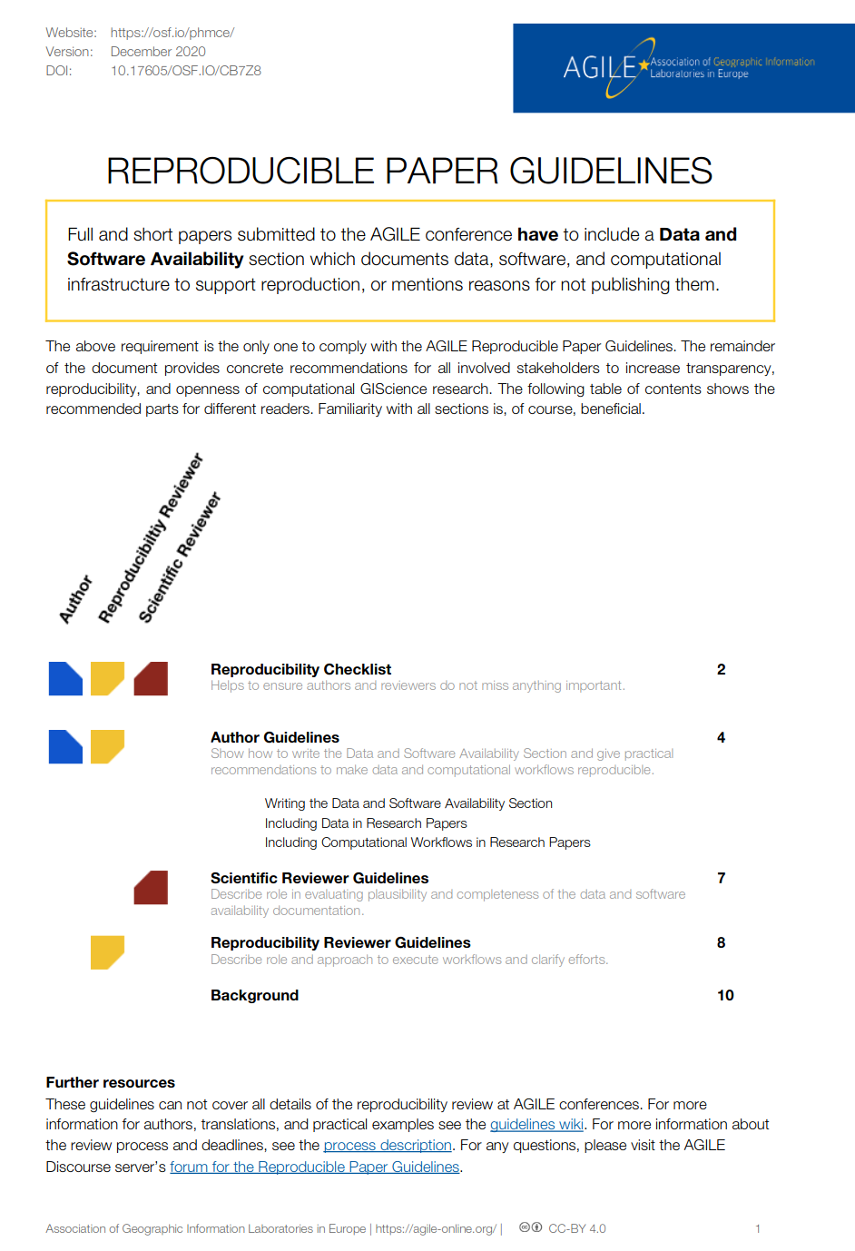
AGILE Reproducible Paper Guidelines 🇬🇧 🇪🇸 ^{(v1)} https://doi.org/10.17605/OSF.IO/CB7Z8
Created by AGILE Initiative in 2019
(see report at https://osf.io/hupxr/)
and updated in 2020
Transparency over
enforcement
Promote, don’t exclude
Acknowledge spectrum
Tailored to GIScience
Notes:
In 2019, AGILE supported an initiative for developing guidelines for reproducible papers.
These guidelines are the first compilation of tipps and tools how to increase transparency in GIScience papers, including a wiki with examples for typical GIScience datasets and workflows.
Their intention is to promote positive examples of reproducible computational research.
Primarily, the guidelines include AUTHOR GUIDELINES, that is how to incorporate DATA and COMPUTATIONAL ​ WORKFLOWS​ IN RESEARCH PAPERS and a section on WRITING THE DATA AND SOFTWARE AVAILABILITY SECTION, or “DASA” section.
Having a DASA section is the only mandatory requirement! It is absolutely possible not to provide any links to data and code and comply with the guidelines at the same time.
These guidelines were put into the call for papers as a recommendation.

Slide 17
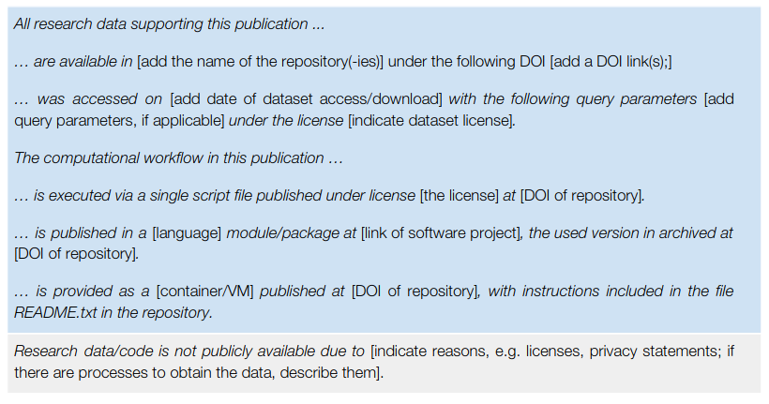
The guidelines
https://doi.org/10.17605/OSF.IO/CB7Z8
Reproducibility checklist
Author guidelines
Writing DASA section
Data in Research Papers
Computational workflows in Research Papers
Reviewer guidelines
Reproducibility reviewer guidelines
Background
Notes:
These are the contents of the guidelines: Primarily, they include AUTHOR GUIDELINES. These give advice how to incorporate DATA and COMPUTATIONAL ​WORKFLOWS​ IN RESEARCH PAPERS, and how to WRITE THE DATA AND SOFTWARE AVAILABILITY SECTION section. There also is a pre-submission checklist for authors.
The document also includes some background on the rationale and motivation, as well as reviewer guidelines and, brand new in the current draft, reproducibility reviewer guidelines.

Slide 18
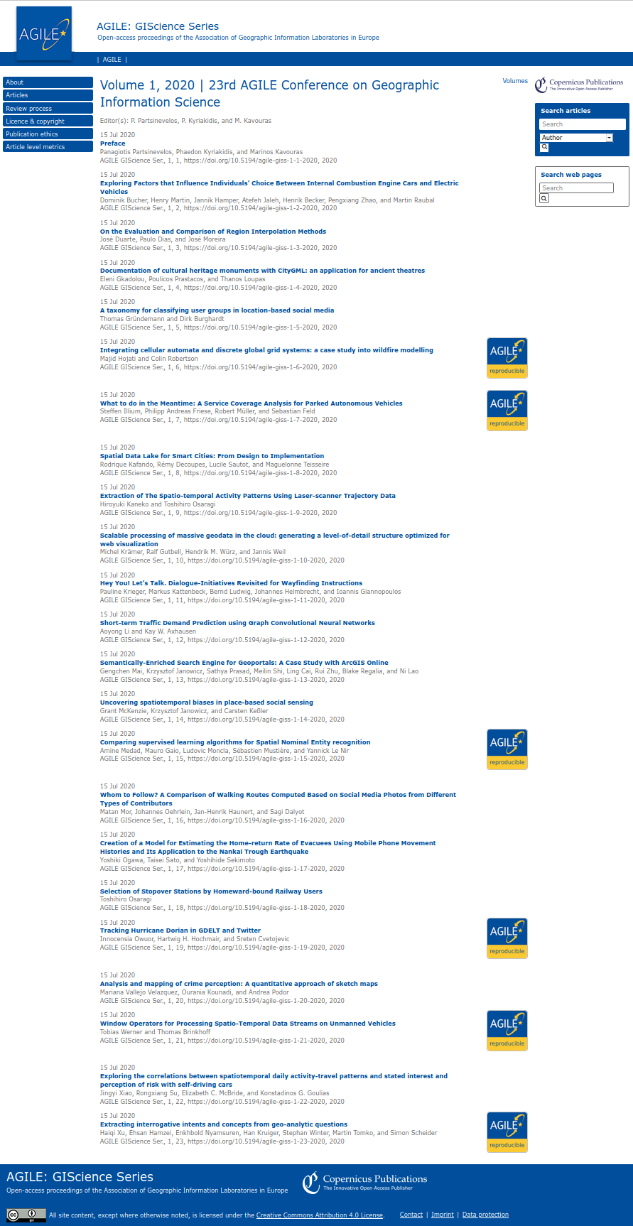
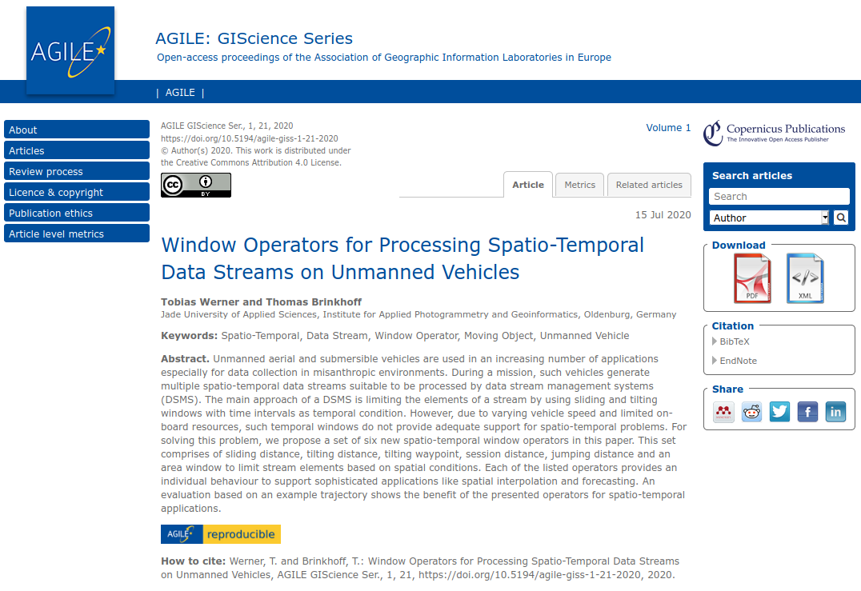
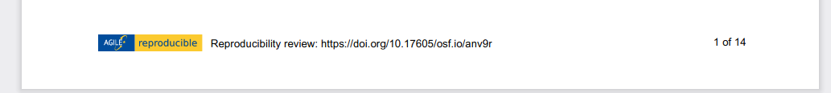
Review process
Proceedings: agile-giscince-series.net/review_process.html
Process documentation: osf.io/7rjpe/
Reproducibility review of full papers after accept/reject decisions by scientific reviewers
Reproducibility review & communication
Community conference & volunteers
Badges on proceedings website and article title page link to reproducibility reports (Thanks Copernicus!)
Notes:
First a few words about the process. You can find the details in the linked document.
Let’s start with the order: the reproducibility review happened after the authors were notified about the acceptance or rejection. Ideally, we wanted to review only papers that were identified by the scientific reviewers, but we found that that was not reliable so we briefly checked all papers ourselves. Also, none of the regular reviewers could be intrigued to attempt a reproduction.
This reduced the number of papers and allowed us to communicate directly with the authors during the reproducibility reviews.
The process was not smooth, because AGILE is a community-led conference managed by volunteers, and the authors are the ones who prepare the camera-ready copies of the articles. So there is a lot of moving parts with no central control. On top of that, the conference switched the publisher and the Coronavirus destroyed all schedules.
Eventually, the papers were published. The publisher added badges on the landing pages of the proceedings, which link to the reproducibility reports, as you can see on the right hand side. The papers themselves do not reference the reports.
We originally planned to have short presentations of selected reproducible papers in the final conference session, where candidates for the the best paper award are presented and voted live by the audience. Unfortunately, the in-person event was cancelled, so we could not have a showcase of the first batch of reproducible papers as we would have liked to.

Slide 19
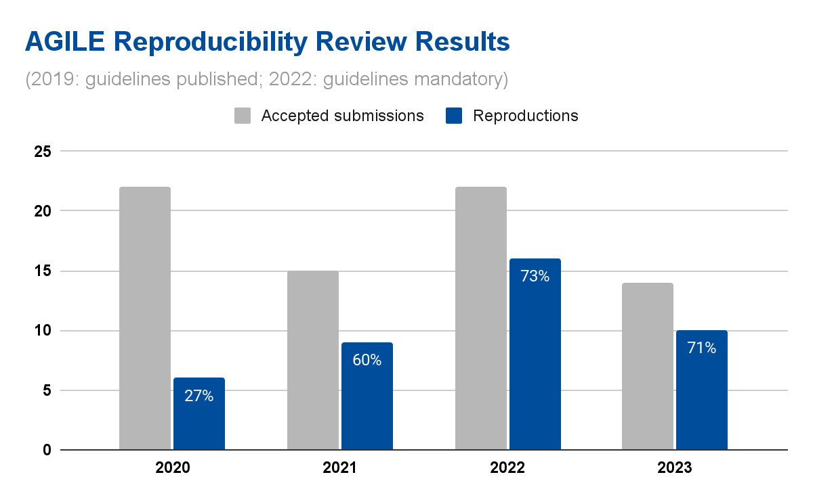

https://osf.io/phmce/
2018-19:? ..-2017: 0?! (see 10.7717/peerj.5072
If not reproducible:
authors say too difficult / too busy
no data nor code (tutorial, conceptual)
big data + prop. tool & code not working
Notes:
Reproducibility Reports are published on OSF and citable with a DOI.

Slide 20
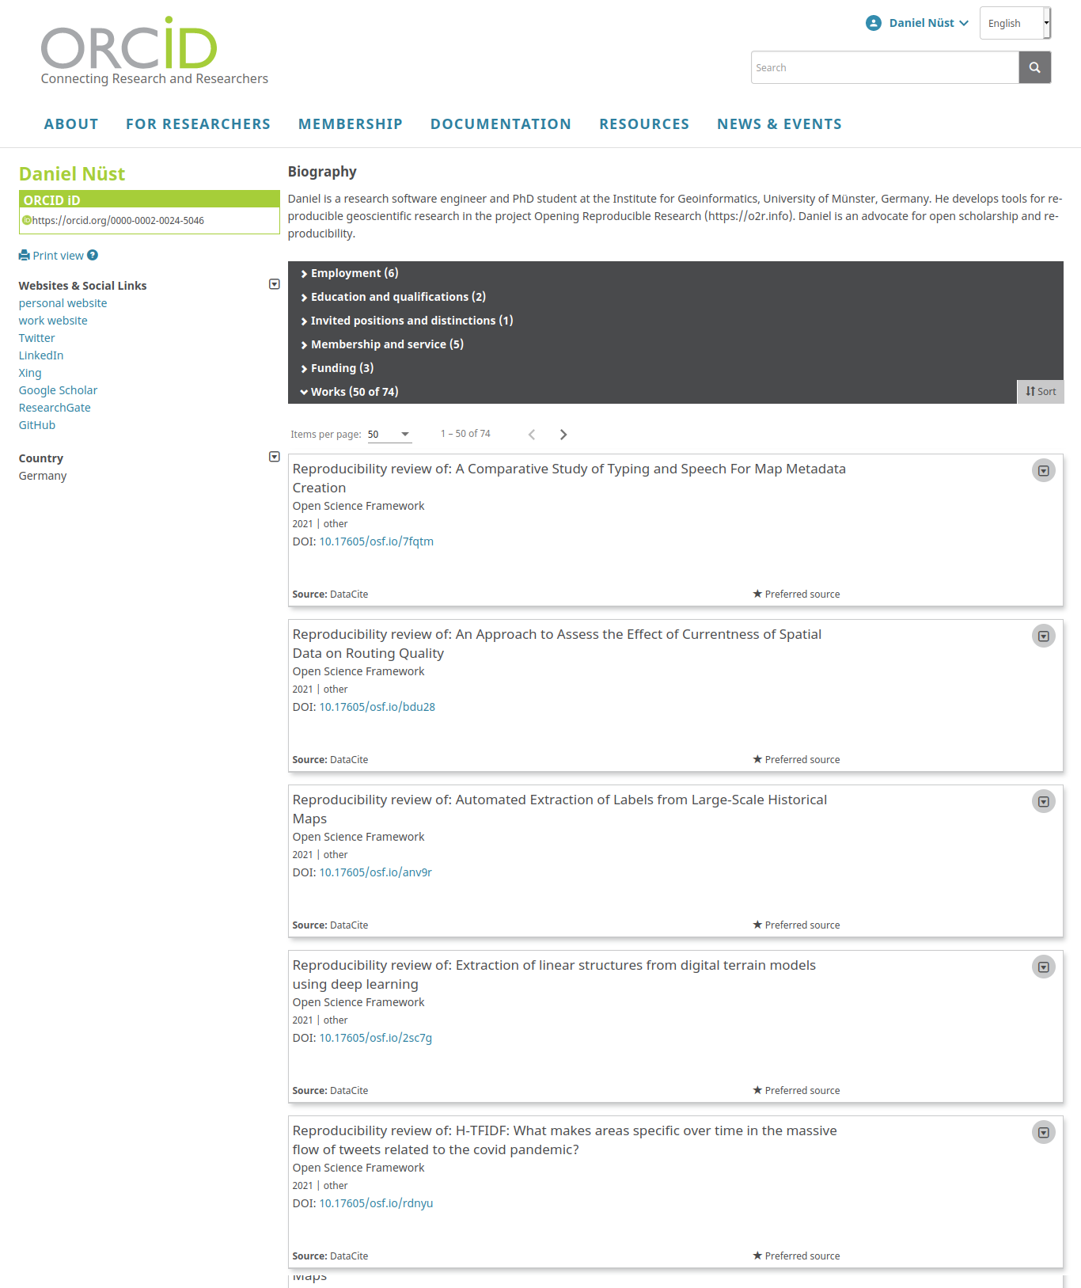
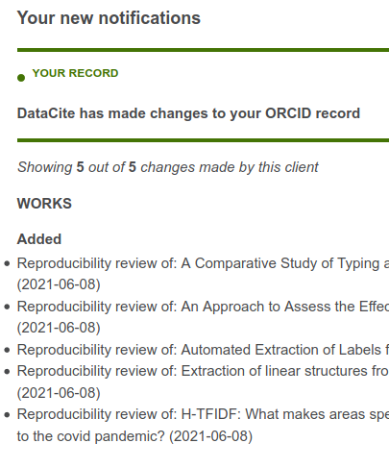
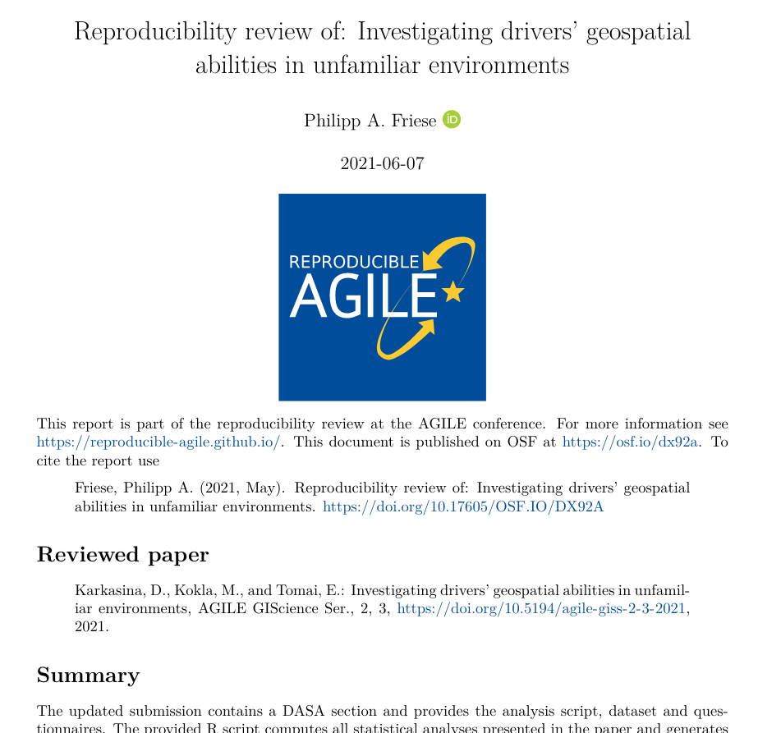
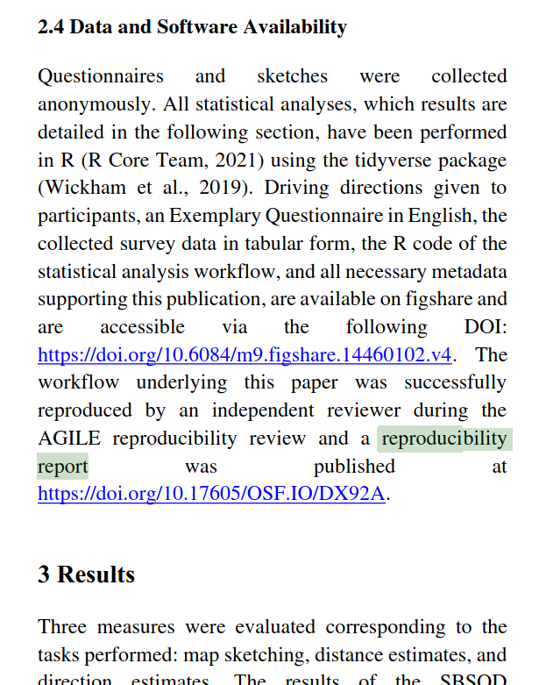
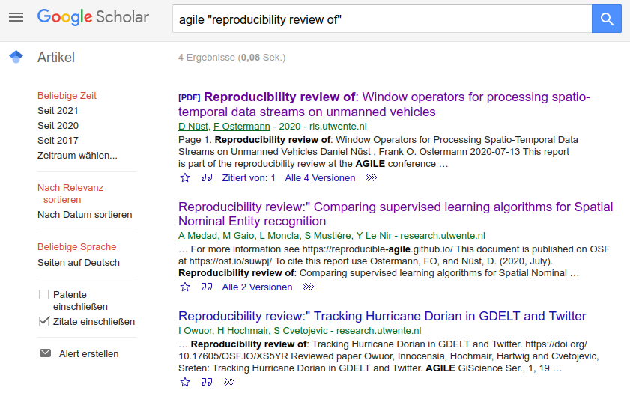
Reproducibility Reports
Published on OSF with a DOI
Title page, cites the paper
Paper links to report via URL
(no citation)
Automatically added to ORCID profile

Slide 21
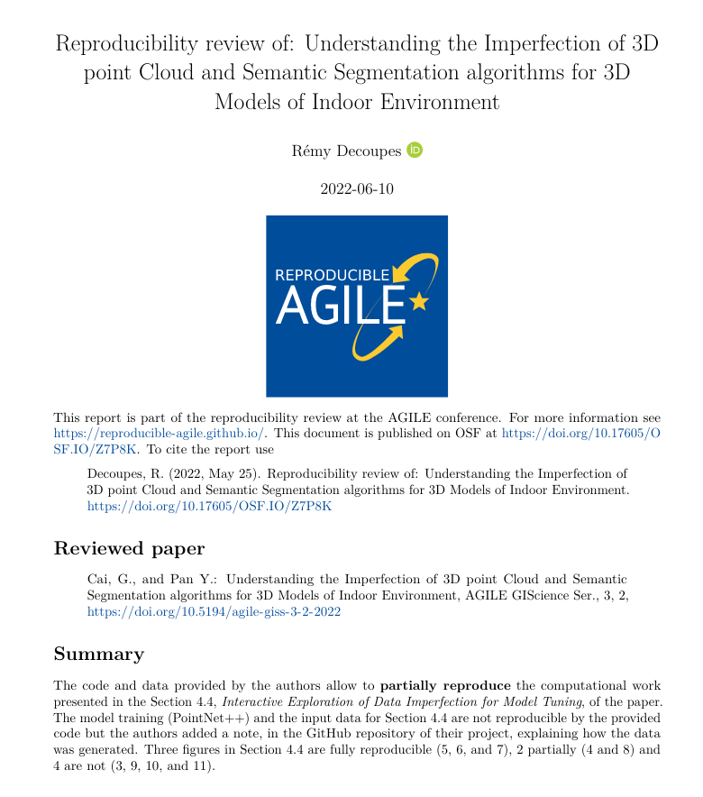
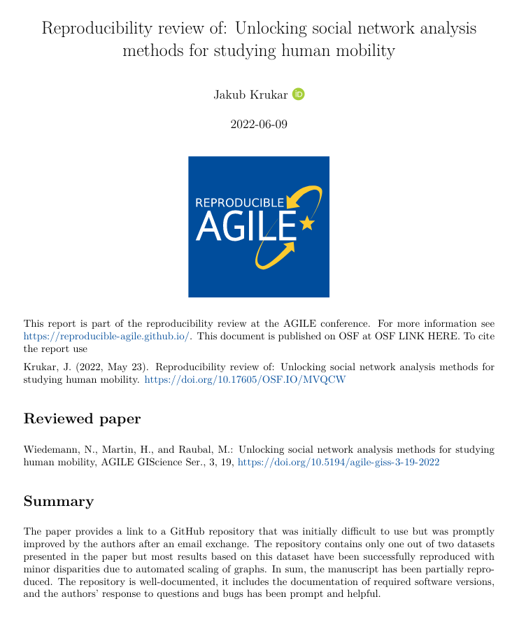
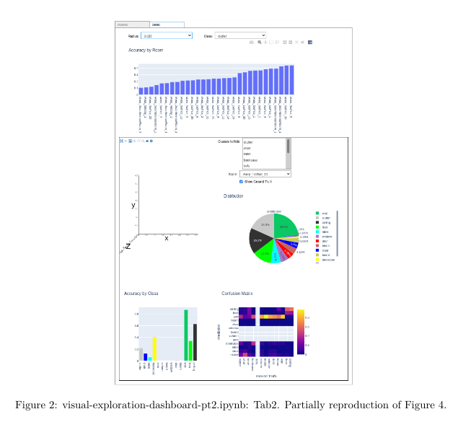
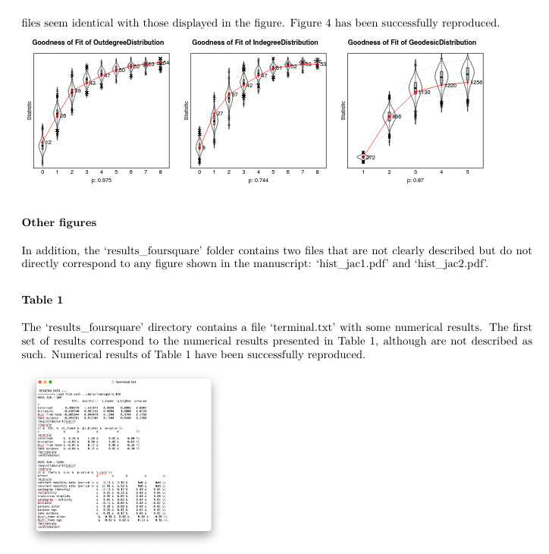
Example reproducibility reviews from AGILE 2022
https://doi.org/10.17605/OSF.IO/Z7P8K
https://doi.org/10.17605/OSF.IO/MVQCW
Notes:
Left: This paper is an outstanding example not because it was fully reproducible, but because, the reviewing process contributed to help the authors to adopt better scientific practices: They added a citation to the original paper that described the tool they used, they added a license to their project, they improve theirs instructions to install the computational environment, and they explained the non reproducible parts of their pipeline in their GitHub repository.
Right: In a similar vein, this paper started as some code lying around at some repo without a README. In response to the reproducibility reviewer’s questions over email, the authors: prepared a pretty README, fixed a few bugs that prevented running the code, and identified a bug in their original manuscript (where an axis in a graph was labelled incorrectly) and corrected the manuscript before publication.

Slide 22
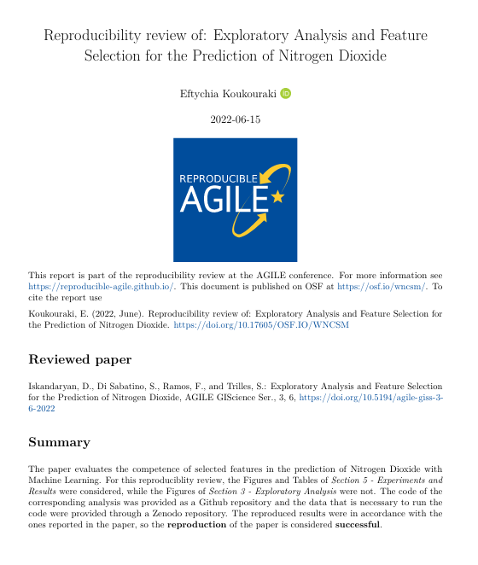
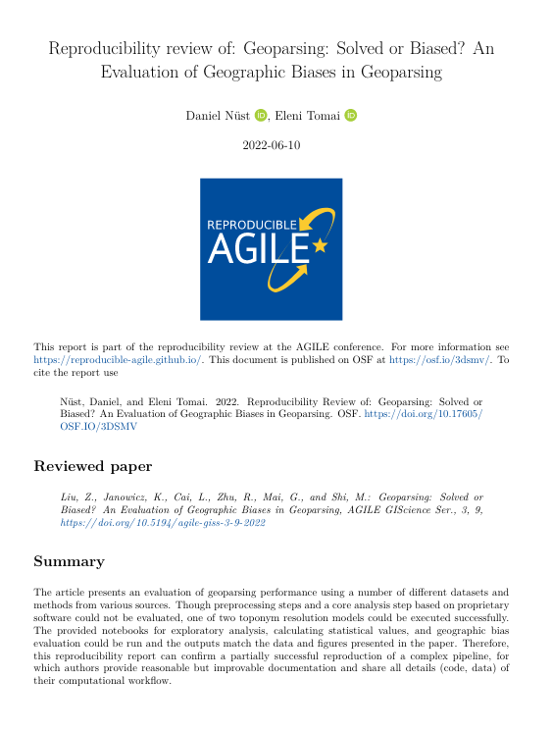
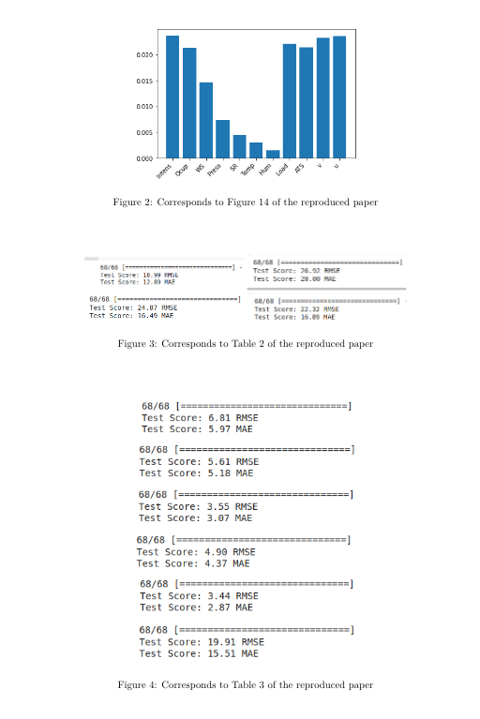
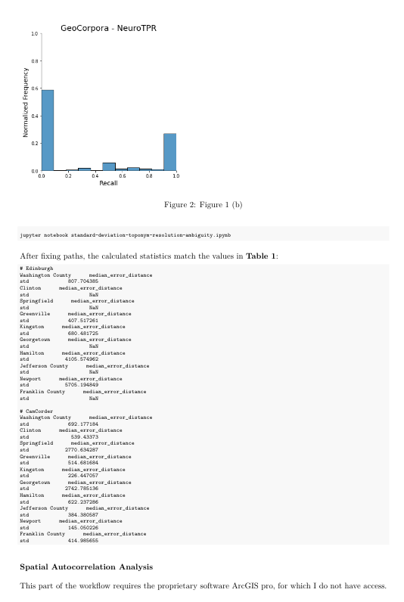
Example reproducibility review reports from AGILE 2022
https://doi.org/10.17605/OSF.IO/W7VPH
https://doi.org/10.17605/OSF.IO/3DSMV
Notes:
Left: Thanks to the conversation with the reproducibility reviewer, authors eventually created a more organized version of their workflow in their GitHub repository. At the beginning their code was not runnable for someone else, and in the end they even provided their trained models on top of the code for the actual training. So it was a learning process for the authors as well, and possibly more for the community: Including the trained models as a kind of pre-processed data component in Machine Learning studies maybe something to consider for future requirements.
Right: This final example shows the limitations of the reproducibility review process, but also that it is worth checking as much as we can! The article partly uses proprietary GIS software for preprocessing and analysis, which could not be checked, but also shares computational notebooks for visualisation and parts of the process could be successfully run.

Slide 23
🙌
How to put your community on a path towards
more reproducibility in 5 easy hard steps
Build a team of enthusiasts (workshop, social events)
Assess the current state and raise awareness (workshop, paper)
Institutional support (🙏 AGILE Council 🙏 + committee chairs)
Positive encouragement (no reproduction != bad science)
Keep at it!
Notes:
In just three years, we were able to plant the seed of cultural and structural change (if I myself may say so). So here is how to put your community on a path towards more reproducibility in 5 easy steps:
Build a team of enthusiasts, for example by organising a workshop
Assess the current state and talk about it - this is how people will realise you are serious; in our case it was pre-conference workshops and a paper with a strong message
Try to get institutional support - in our case the support of the AGILE Council and the conference committee chairs made everything possible
Try to get the community on your side by staying positive and inclusive - irreproducibility is usually not a sign for bad science, but for a lack of knowledge and incentives, which you can try to create
Keep at it, cultural change takes time - putting reproducibility on the map is an achievement in itself, and every little step counts; providing feedback as part of the reproducibility reviews will, one author at a time, educate your community.

Slide 24
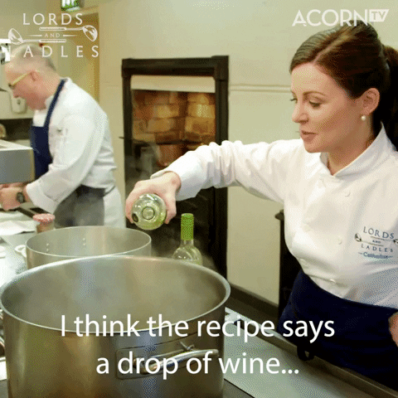
From AGILE to EVERYWHERE
CODECHECK is transferable to your discipline:
human-centered process, communicative focus, supportive framework of tools and infrastructure, and candidates.
https://giphy.com/gifs/acorn-tv-wine-cooking-recipe-BhsSZR0k6EMxjCQDwP
Notes:
https://giphy.com/gifs/cbc-funny-comedy-xT9IgzFnSqzt2Sp3EI

Slide 25
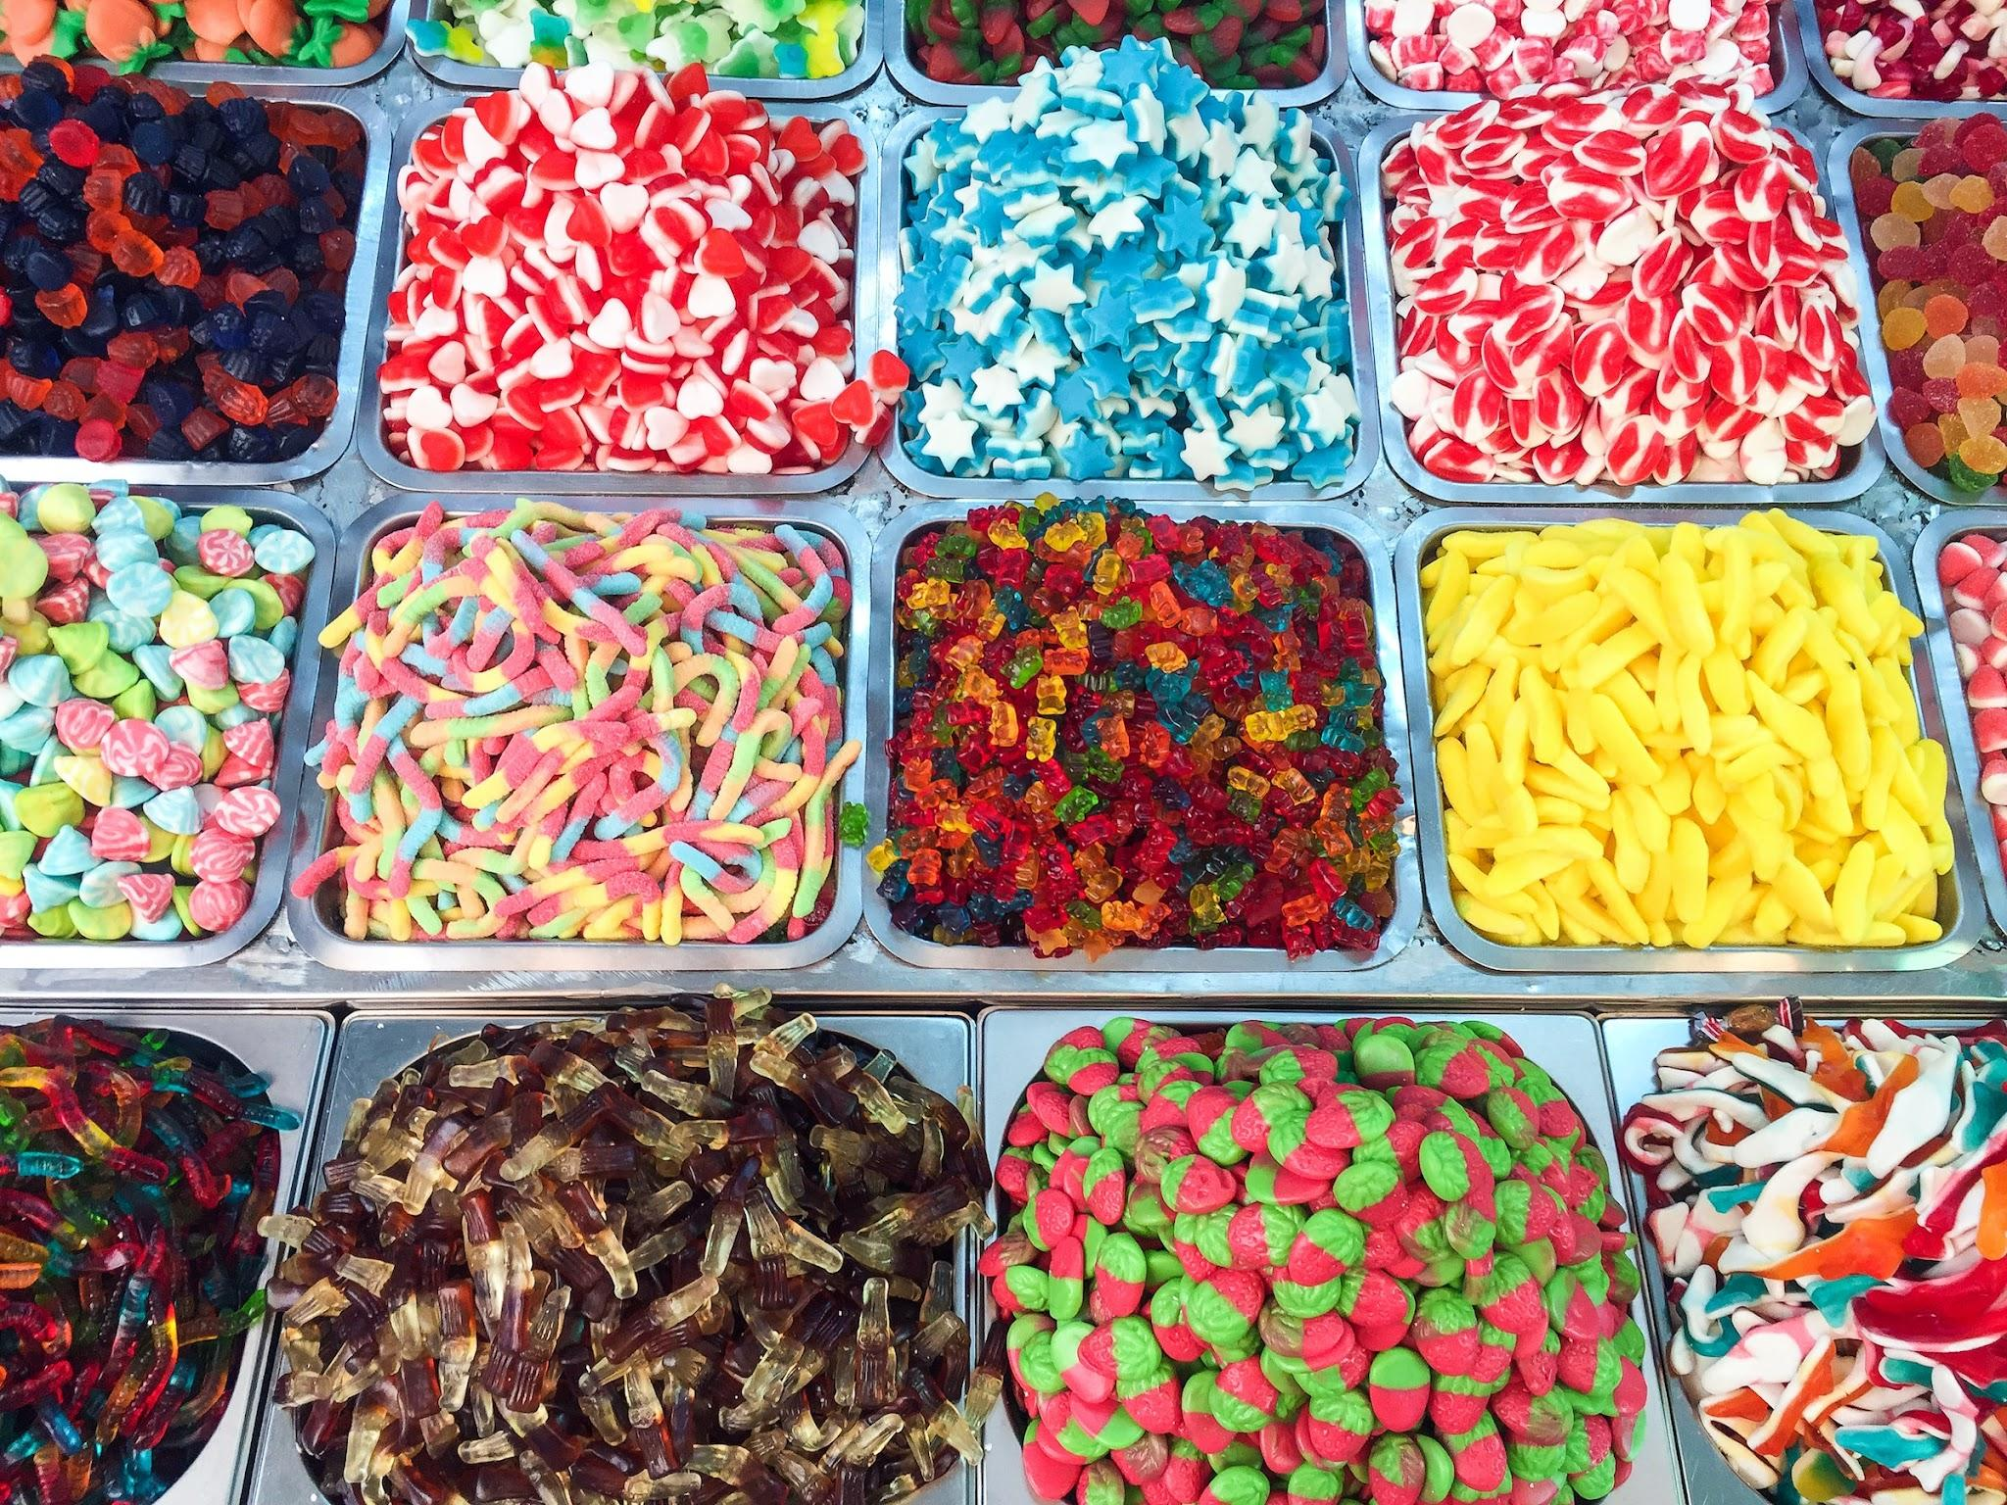
‏‏‎ ‎Human(with RSE skills)-centered process‏‏‎ ‎ handles variety‎‏‏‎ ‎
Author provides material and makes fixes
Collaborate to make things work
Codechecker stops when confident enough all parts are provided and then gives review
… by transferring the challenge to codechecker matching?
Photo JACQUELINE BRANDWAYN | Unsplash
Notes:
First, Reproducible AGILE’s human-centered process is able to handle the increasingly complex, large and varying data-based workflows in ESS because of the clear guidance on responsibilities
What should the author provide?
How far does the reproducibility reviewer need to go?
Large data? Bespoke script? Latest tool version? Niche compiler?

Slide 26
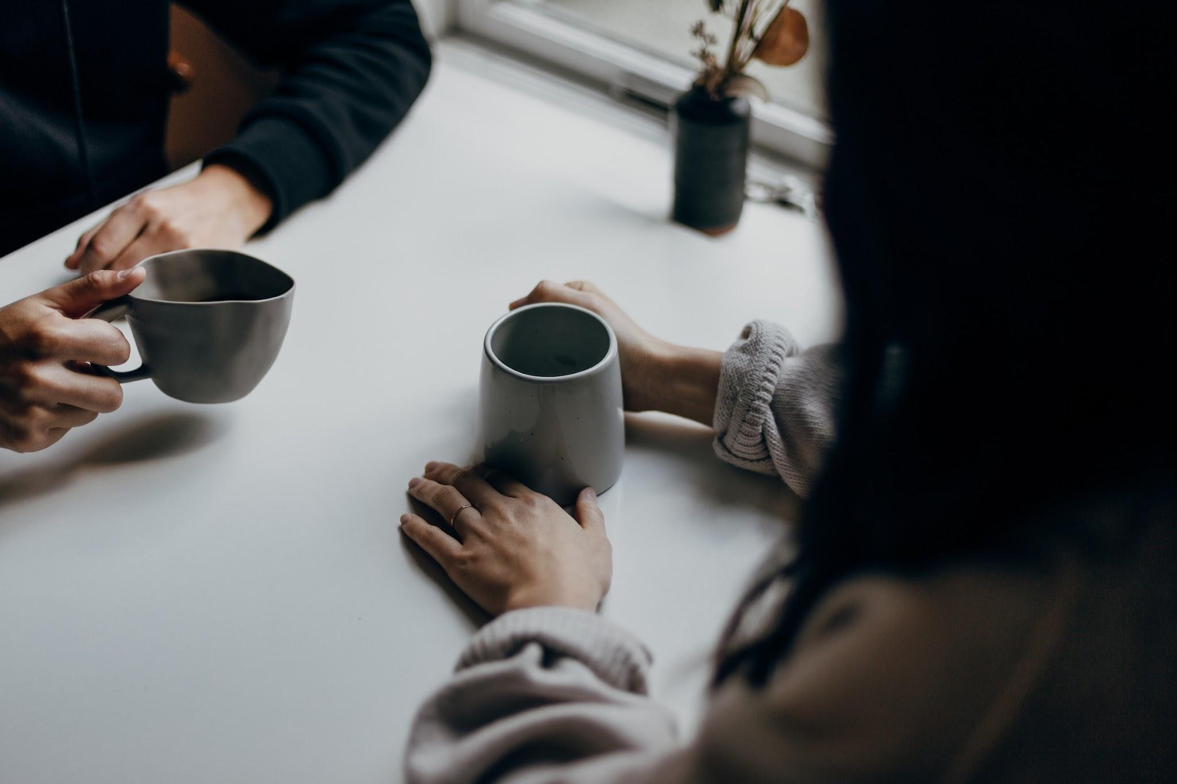
‎Communicative focus for reproducibility.
Avoids rules & automation playing catch with innovation & technology
Avoids unification or limitation of researcher freedom
Continuous development of shared practice over time
& definition of “reproducibility” and “how reproducible is enough"
Targets attitudes towards sharing, transparency, and openness
Positive learning experience for all involved roles
Photo by Priscilla Du Preez | Unsplash
Notes:
Second, the communicative focus of the process is very well suited to, over time, help to establish a shared practice based on current technical developments, such as FAIR Digital Objects, and to reform attitudes towards openness, transparency and sharing. A code execution following the CODECHECK principles is a learning experience that may sustainably change researcher behaviours and practice. At the same time, Reproducible AGILE’s approach avoids playing catch-up with technology and does not limit researcher freedom or includes a need to unitise researcher workflows beyond providing instructions suitable for a human evaluator, similar to academic peer review.

Slide 27
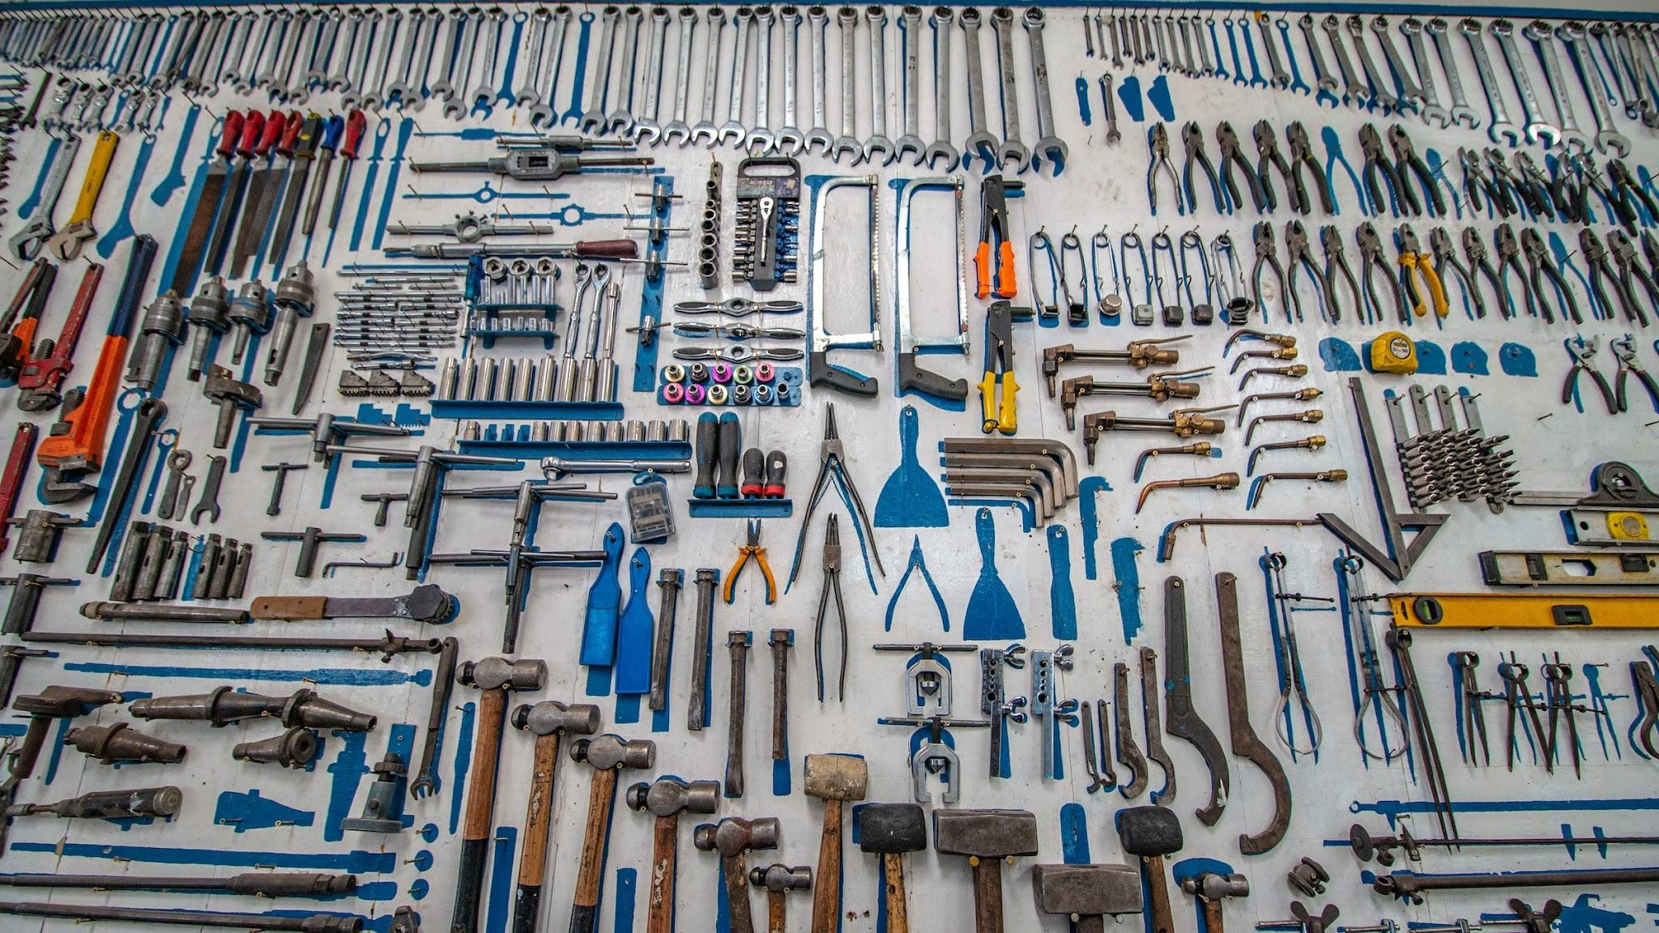
Tools & infrastructure.
Faster codechecking with…
Notebooks
Binder (BinderHub)
Open methods
Missing?!
- free Binder-ready notebooks close to the data
- metadata connectivity > credit & partial re-building
- (small) reference datasets & demo pipelines
Photo by Cesar Carlevarino Aragon | Unsplash
Notes:
Third, while being agnostic of technology and infrastructures, a supportive framework of tools and infrastructure can of course increase the efficiency of conducting a code execution. We outline how existing infrastructures may serve this need and what is still missing.

Slide 28
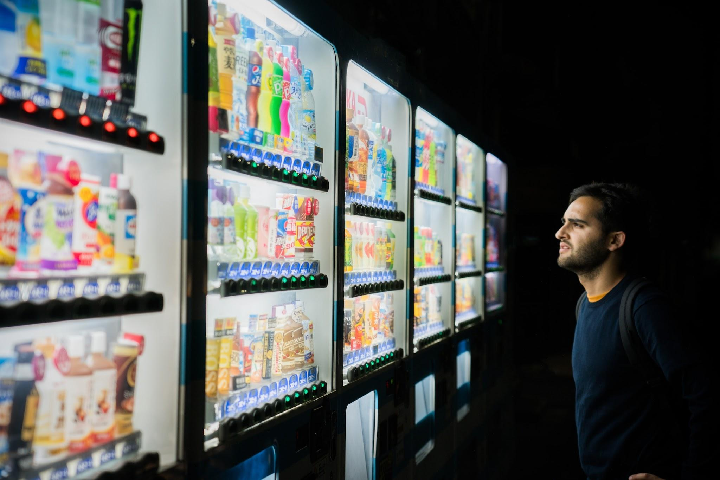

Candidates to apply CODECHECK?
Photo Victoriano Izquierdo | Unsplash
Notes:
[..]
YOU TELL ME! I’d be interested to make it happen together with you!
Fourth, we list potential candidates of event series or journals that could introduce a code checking procedure because of their organisational setup or steps towards more open scholarhip that were already taken.
Alternative image: https://unsplash.com/photos/C7B-ExXpOIE

Slide 29

What can you do today?
Notes:
Mindset MORE important than tools.
So, it is really hard to make predictions about peer review, because, well, we can’t see into the future.
Here are a few things that I want to invite you start doing today.

Slide 30
Learn how to
CODECHECK and join/start a local/journal/conference community of codecheckers to shift practice one paper at a time. https://codecheck.org.uk/
Notes:
The first project is called CODECHECK.

Slide 31
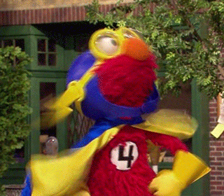
Who will look into the research compendia?
RSE
https://giphy.com/gifs/muppetwiki-sesame-street-muppets-elmo-TH1doTnuEWR2Ntdnyy
Notes:
YOU!

Slide 32
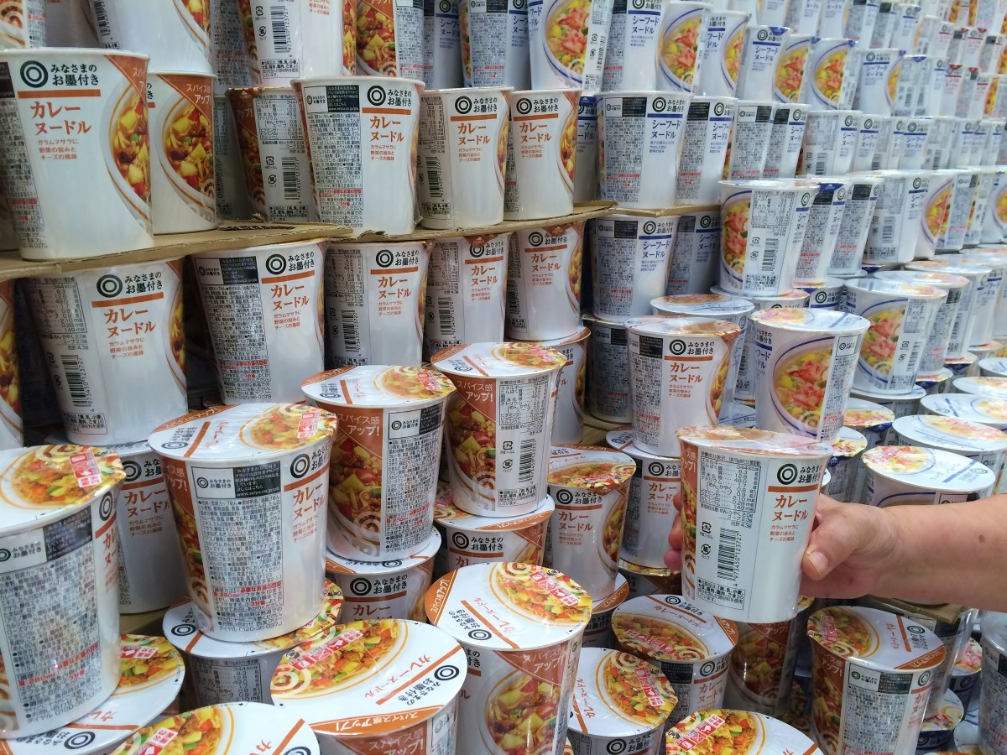
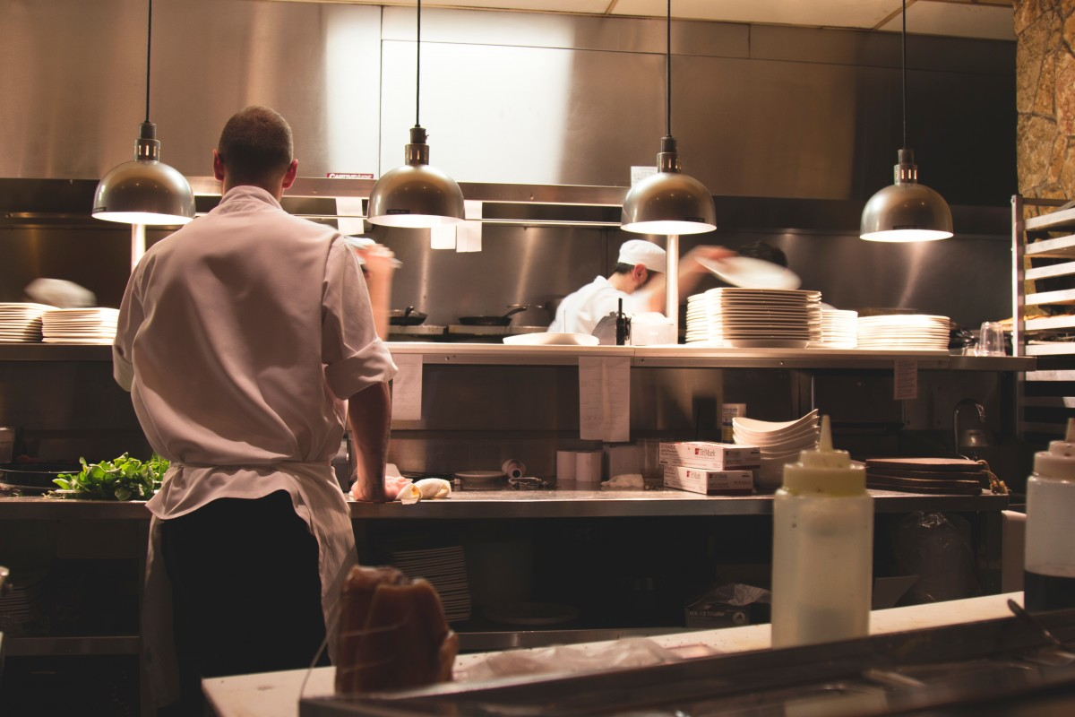
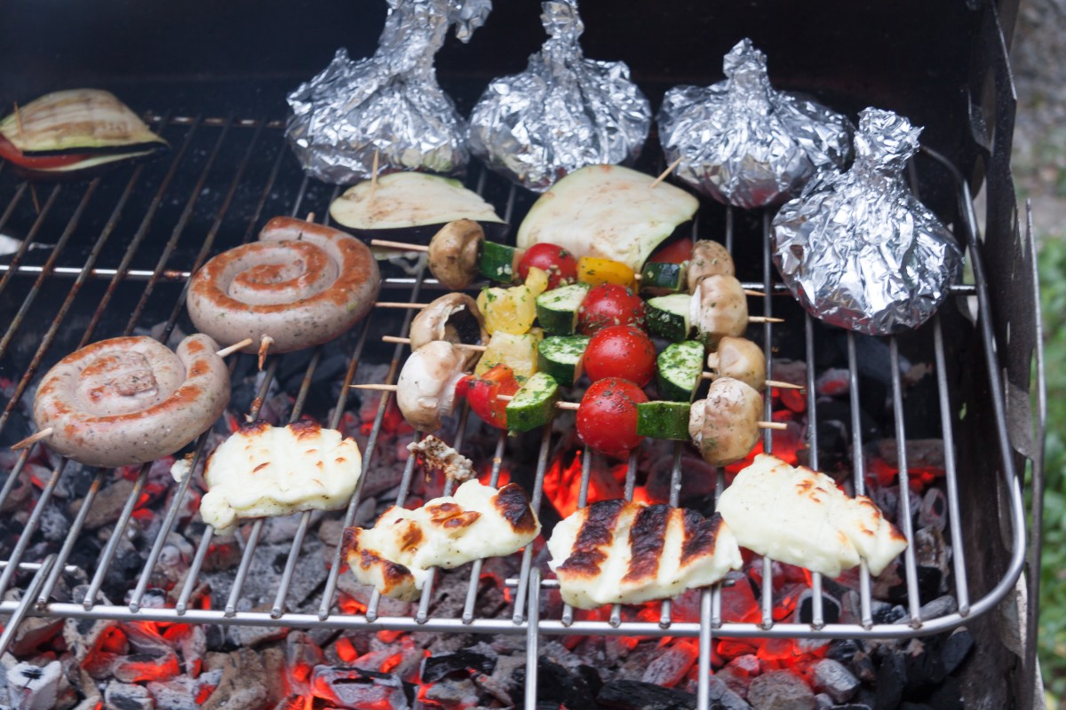
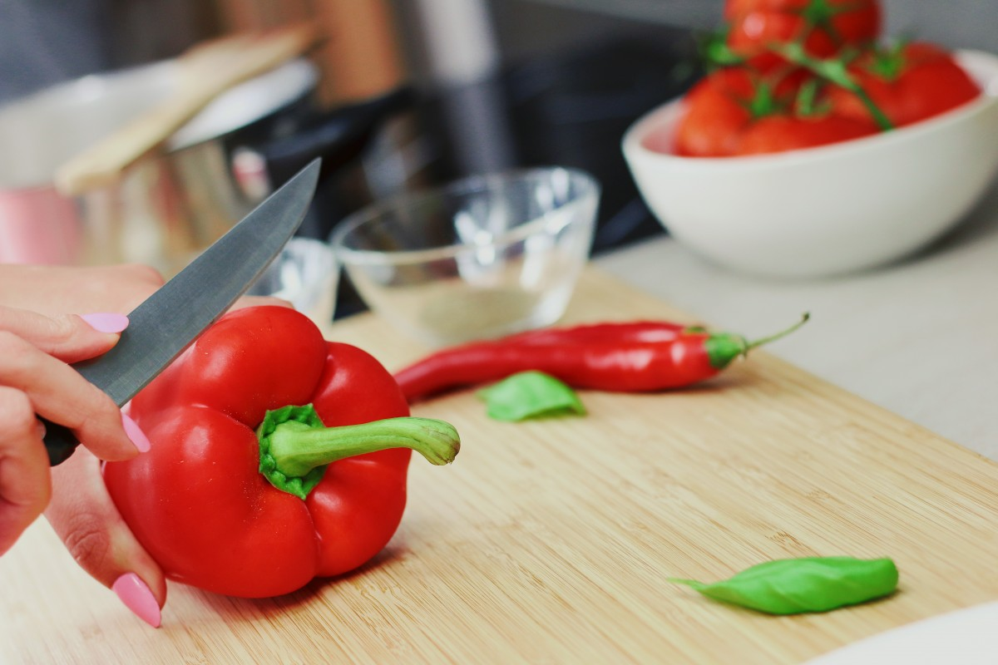
≠
Professionalisation
Images: https://pxhere.com/en/photo/477458 https://pxhere.com/en/photo/1087259 https://pxhere.com/en/photo/703106 https://pxhere.com/en/photo/103038
Notes:
Here’s an image that I find useful that explains why professionalisation matters:
We can all prepare food so that we do not starve. For some that means that they pour boiling water into a cup of ramen, for some that means to fire up the barbeque with friends, for others it means to cook fresh and healthy food every day.
However, when we want to eat very good, or we want to serve many people at once (think about the Mensa), we go to the professionals.
Or is here someone, who cooks themselves when they throw a party or take out their own cooker in the office?
Without professional-grade software development, the progress in science will be slower. And these developers must, to some extent, understand the science and speak the language of the researchers.

Slide 33
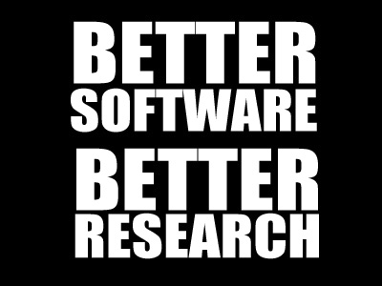
checking of
by RSEs
improves peer review to foster
Notes:
Software development is an essential, integral part of research activity. Research software increasingly supports the acquisition, processing and analysis of empirical data, but also the modeling and the simulation of complex processes. Thus, software has a significant influence on the quality of research results. The British Software Sustainability Institute (SSI) has coined the slogan “Better Software - Better Research”.

Slide 34
What else can you do?
Strive for best reproducibility when sharing research
Use RSEng expertise as peer-reviewer and be demanding
Initiate discourse on code execution if you are an author, reviewer, editor, …

Slide 35
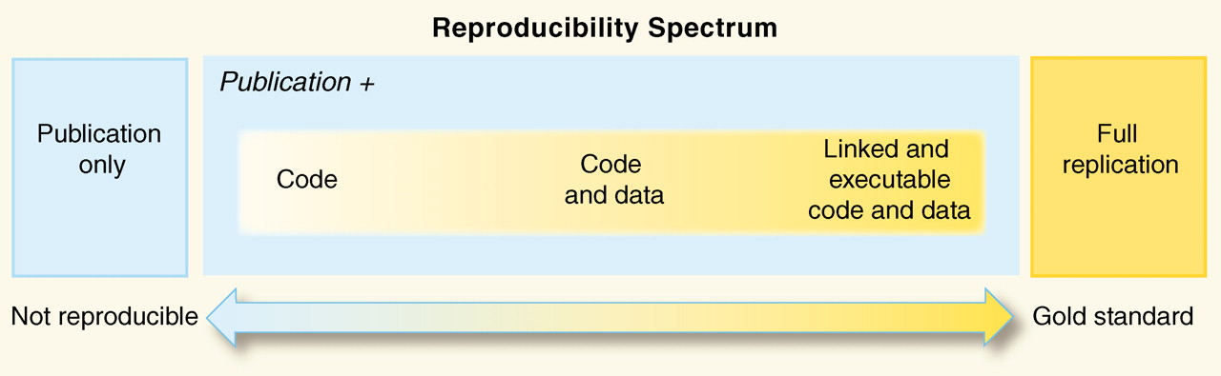
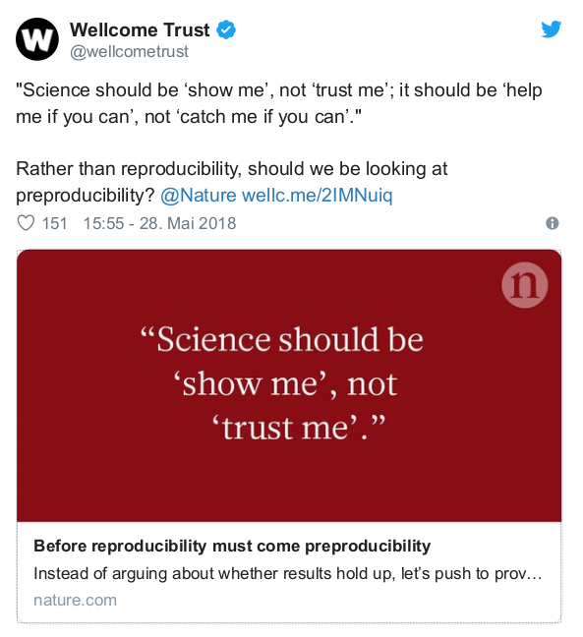
Reproducible Research & Open Science
https://doi.org/10.1126/science.1213847
https://www.nature.com/articles/d41586-018-05256-0
Notes:
Reproducibility Spectrum by Roger Peng
------
Preproducibility ist ein Neologismus von Philip B. Stark als als Alternative zu den verwirrenden oder unterschiedlich interpretierten existierenden Begriffen, nämlich: "An experiment or analysis is preproducible if it has been described in adequate detail for others to undertake it. Preproducibility is a prerequisite for reproducibility, and the idea makes sense across disciplines. [...] Science should be ‘show me’, not ‘trust me’; it should be ‘help me if you can’, not ‘catch me if you can’." Lesenswert: 10.1038/d41586-018-05256-0 !

Slide 36
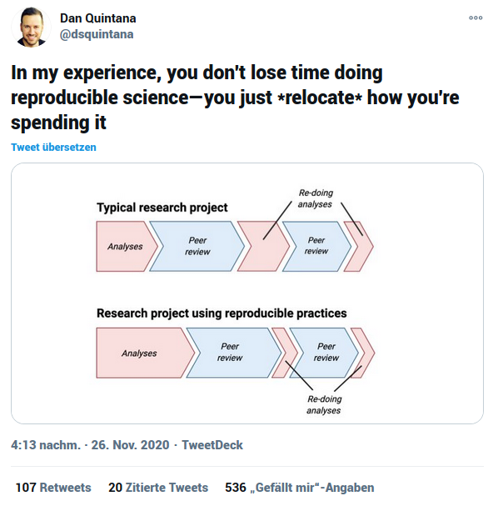
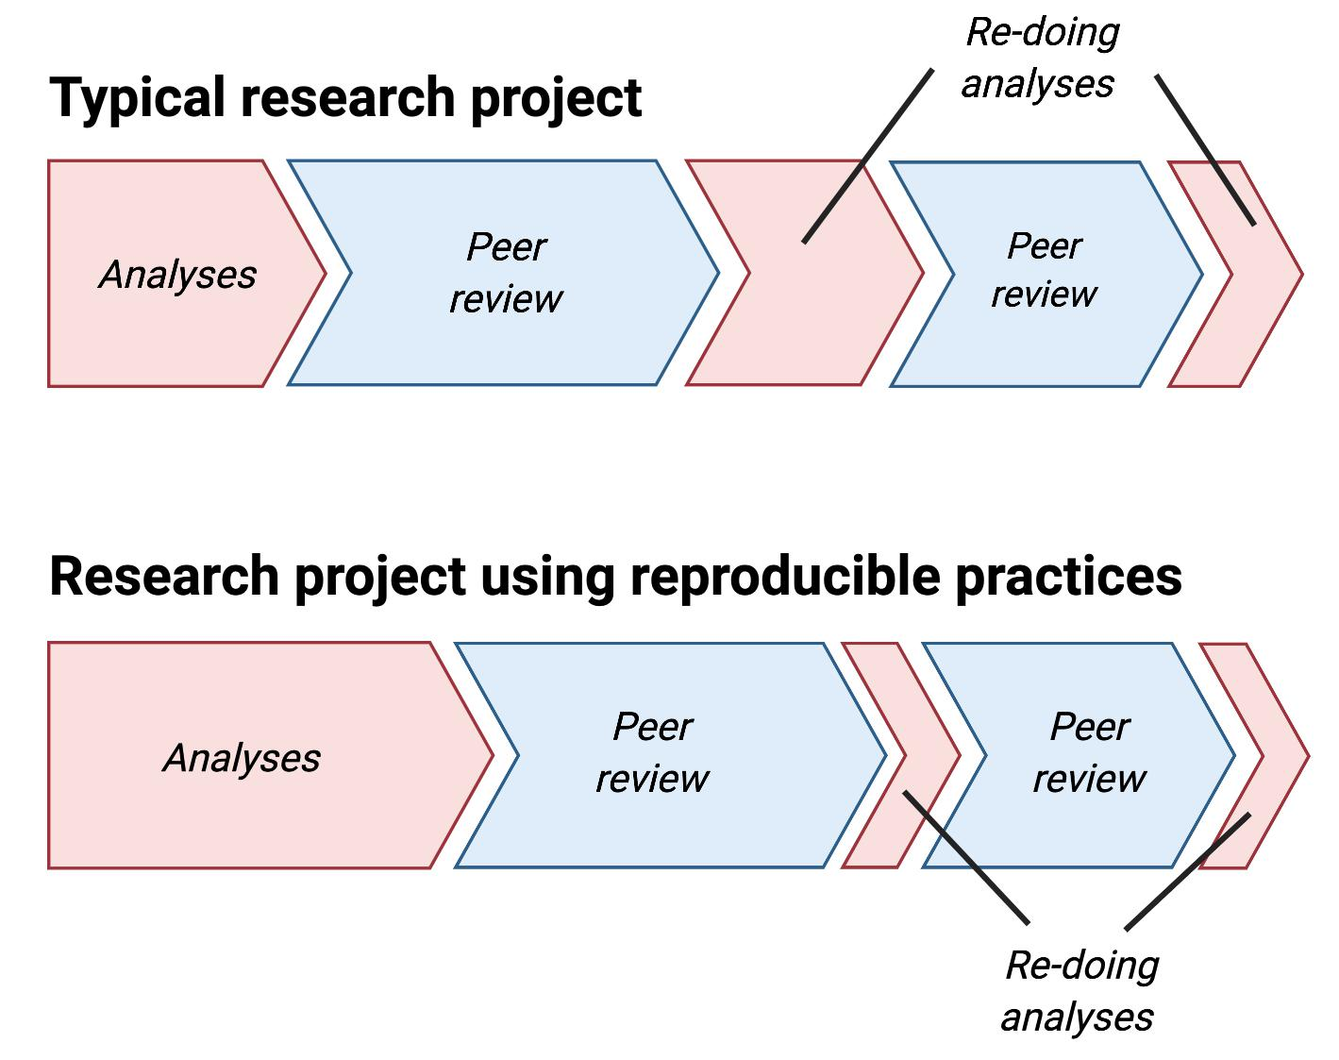
Quintana, D. S. (2020, November 28). Five things about open and reproducible science that every early career researcher should know. https://doi.org/10.17605/OSF.IO/DZTVQ
Notes:
And while better reproducibility to answer journal requirements might be the only way to introduce real change, let’s be clear that using reproducible practices is not something that you only do for you, but something that you can apply just for yourself! This is a recent tweet by Dan Quintana, who makes it clear that the extra time you might feel you have to spend in the beginning, really pays off later in the research process when you have to adjust you analysis, and even further down the road when you want to write your next paper.
Reproducibility is the basis for reusability and collaboration, and future you is your best collaborator.

Slide 37

Research Compendia
= programming language packaging + science stuff
= templates
= community practices
(lab, discipline, language, method) research-compendium.science
Notes:
I also have no perfect resource for a “template” or approach.

Slide 38

What can communities and institutions do?
Introduce reproducibility reviews - CODECHECK (or not) - at your journals, labs, collaborations!
Workshops on RCR, ReproHacks
Provide support
Establish rewards and incentives
Enable community discourse
Awareness > Change
https://giphy.com/gifs/chicagodancecrash-KCqjrcPfL55q3MkgHZ
Notes:
Introduce reproducibility reviews, top down if you’re an editor, or buttom up if your’re author or reviewer. Just do it, it will shift practice over time.
Become and advocate and educator! You can organise a workshop or a ReproHack, and help more and more community members build up the expertise to work more reproducibly. A lack of reproducibility is rarely intentional or supported by a strong opinion, but a lack of knowledge and rewards.
Create incentives and rewards.
Awareness leads to change. In the AGILE community, the team behind Reproducible AGILE was able to get from zero to six reproducible papers in three years, which I’m really proud of. However, I must admit this was only possible because we had institutional support.
We’re still working hard to find journals who want to establish CODECHECKs.
One tiny step at a time is still progress, and as this dancer shows us, you can still be very powerful and graceful.

Slide 39
What do you get?
You can help people to write code that can be understood by others, can be reused, and can be improved. Your feedback will be welcome and valued by researchers.
You can give back to the community. You can reduce people’s pain by helping to improve “academic” codebases. Spread good practices in academic software use and development. You help to increase availability and usefulness of code and data in your discipline and others.
It connects you with a journal’s community, experiences in pee review (seeing the latest stuff) & reviewer credit, gives recognition in academia.
You get to know all the package managers. All of them. You learn useful tools and practices for your own work.
Understanding other people’s code trains your skills, peeking into fields of research outside of your own.
You meet possible collaborators and foster collaboration & reuse over reinventing the wheel.
You can push publishing practices in the right direction and contribute to establishing a more open and friendly culture of reproducible research.
These statements are inspired by motivations shared by the awesome volunteer codechecker community: https://github.com/codecheckers/codecheckers

Slide 40



Learn crafts by doing. Be kind. Help.
THANKS! What are your comments and questions? https://bit.ly/check-cam
Notes:
It’s a craft. Coding is a craft, reproducing computations is a craft. There is a reason why pair programming, for example, is used in software development.
I have been regularly asked about educational material for reproducing code, and my answer is: almost impossible to do it in a concise way, too many special cases. The best is to ty to do it and be kind to yourself and others.
For CODECHECK, for example, we would like to establish a mentorship programme, where an experienced codechecker helps others as they build up their skills.
https://giphy.com/gifs/TLCTurkiye-zRJUWfWxOgxJI9LwTL
https://giphy.com/gifs/work-working-beat-it-MZRVq2nKh6pQcCHD24
https://giphy.com/gifs/nba-expression-derrick-white-1n833bZxdzKzaErLe9

Slide 41


https://www.magd.cam.ac.uk/user/eglen | https://www.maths.cam.ac.uk/person/sje30
THANKS! What are your comments and questions? https://bit.ly/check-cam
Walk over and talk to…
Notes:
It’s a craft. Coding is a craft, reproducing computations is a craft. There is a reason why pair programming, for example, is used in software development.
I have been regularly asked about educational material for reproducing code, and my answer is: almost impossible to do it in a concise way, too many special cases. The best is to ty to do it and be kind to yourself and others.
For CODECHECK, for example, we would like to establish a mentorship programme, where an experienced codechecker helps others as they build up their skills.
https://giphy.com/gifs/TLCTurkiye-zRJUWfWxOgxJI9LwTL
https://giphy.com/gifs/work-working-beat-it-MZRVq2nKh6pQcCHD24
https://giphy.com/gifs/nba-expression-derrick-white-1n833bZxdzKzaErLe9

